Slide 2
The Bible & The Age of the Earth
By: Paden Reed, M.S.

Slide 3
Overview
Different Views on Genesis
Biblical Reasons for a Young Earth and Historical Narrative of Genesis
Common Objections to a Literal Interpretation of Genesis Answered

Slide 4
Overview
Different Views on Genesis
Biblical Reasons for a Young Earth and Historical Narrative of Genesis
Common Objections to a Literal Interpretation of Genesis Answered

Slide 5
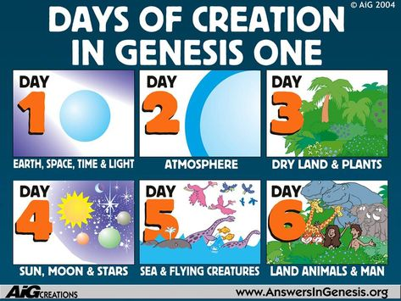
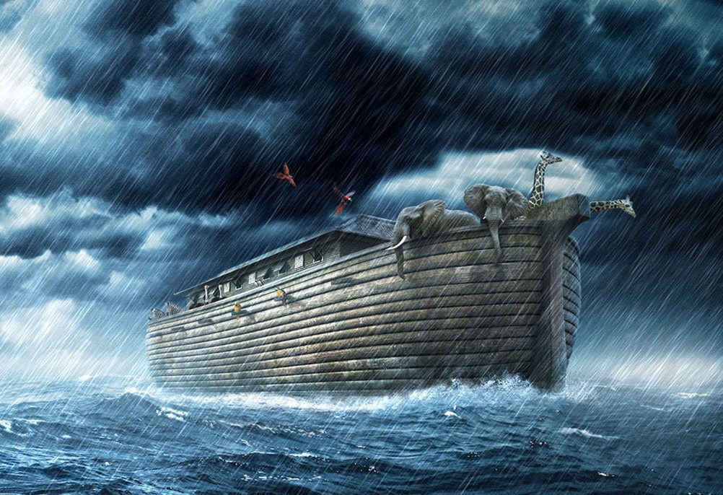
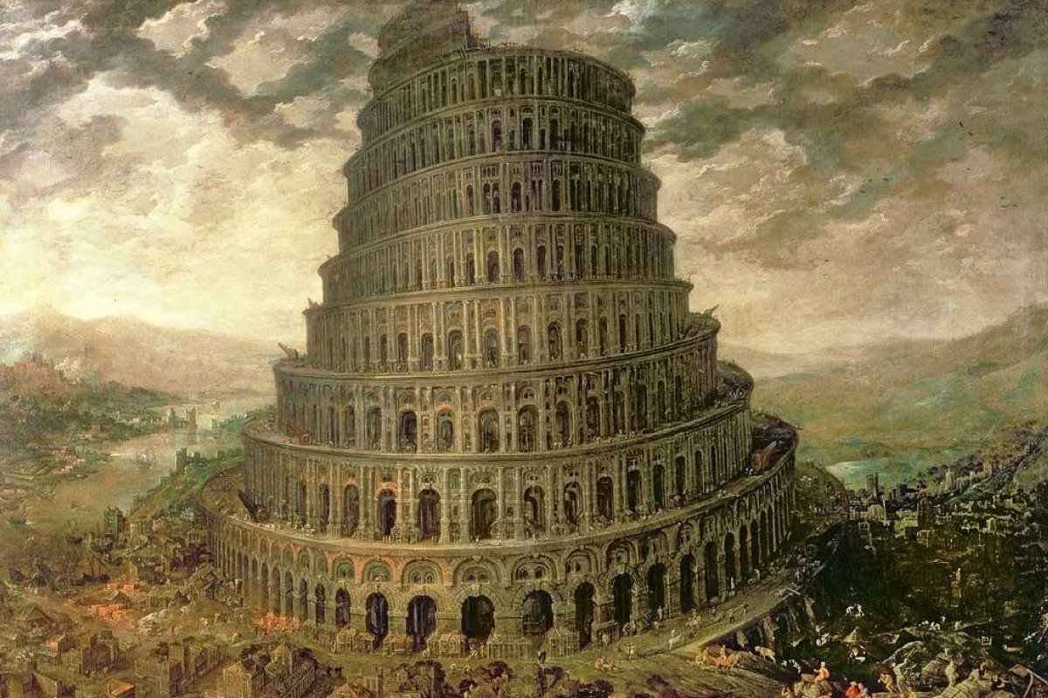
Genesis 1-11
Ch 1-2: Creation Account
Ch 3: Fall of Man
Ch 4: Cain & Abel
Ch 5: Genealogies – Adam to Noah
Ch 6-10: Noah & The Flood
Ch 11: Tower of Babel

Slide 6
Two Views of Scripture
Concordism – The idea that Biblical and non-biblical data on a topic can and should be harmonized
Non-Concordism – The idea that concepts and ideas in the Bible do not need to be harmonized with non-biblical data

Slide 7
Genesis 1:3
Then God said, “Let there be light”; and there was light.
OR…

Slide 8
Concordism
Psalm 33:4
For the word of the Lord is right, And all His work is done in truth.
John 17:17
Sanctify them by Your truth. Your word is truth.
1 Timothy 3:16-17
All Scripture is given by inspiration of God, and is profitable for doctrine, for reproof, for correction, for instruction in righteousness, that the man of God may be complete, thoroughly equipped for every good work.

Slide 9
Old Earth Creationism
OEC believes that the Earth and Universe are ancient according to modern day mainstream science and that this view can be harmonized with scripture. OEC typically views Genesis as figurative or poetical and not as historical narrative. OEC explains Genesis through ideas like the Gap Theory, Day-Age Theory, or the Framework Theory. OEC typically teaches the Noahic flood was local and not global.

Slide 10
Young Earth Creationism
YEC believes that the Earth and Universe were created about 6-10k years ago according to the genealogies given in scripture. They understand the events of Genesis 1-11 to be written in historical narrative. They do not reject mainstream observational science but disagree with assumptions and interpretations made from observable data. YEC teaches that when secular assumptions are replaced with Biblical assumptions, modern day dating techniques give young ages for the Earth and Universe.

Slide 11
Overview
Different Views on Genesis
Biblical Reasons for a Young Earth and Historical Narrative of Genesis
Common Objections to a Literal Interpretation of Genesis Answered

Slide 12
Overview
Different Views on Genesis
Biblical Reasons for a Young Earth and Historical Narrative of Genesis
How do we get an age of 6,000 years?
What type of literature is Genesis?
Why does it matter?

Slide 13
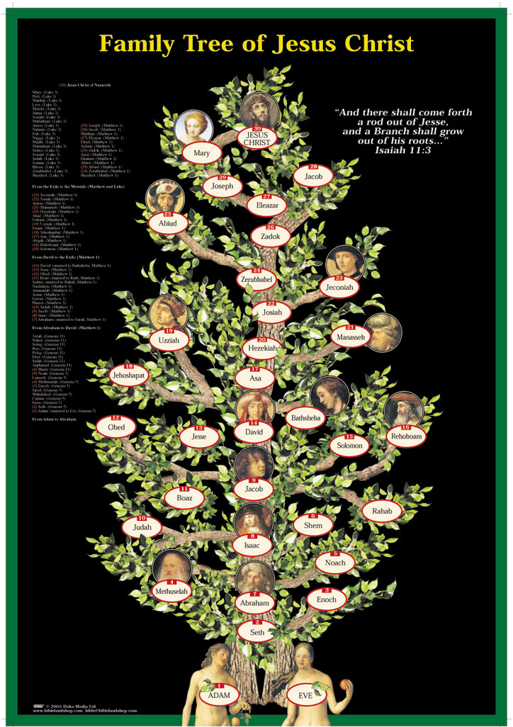
Biblical Timeline
Genesis 5: Adam to Noah & Sons
Genesis 10: Lineage of Noah’s Sons
Genesis 11: Shem to Abraham
1 Chronicles 1-2: Adam to Abraham to David
Mathew 1: Abraham to David to Christ
Luke 3:23-38: Adam to Christ

Slide 14
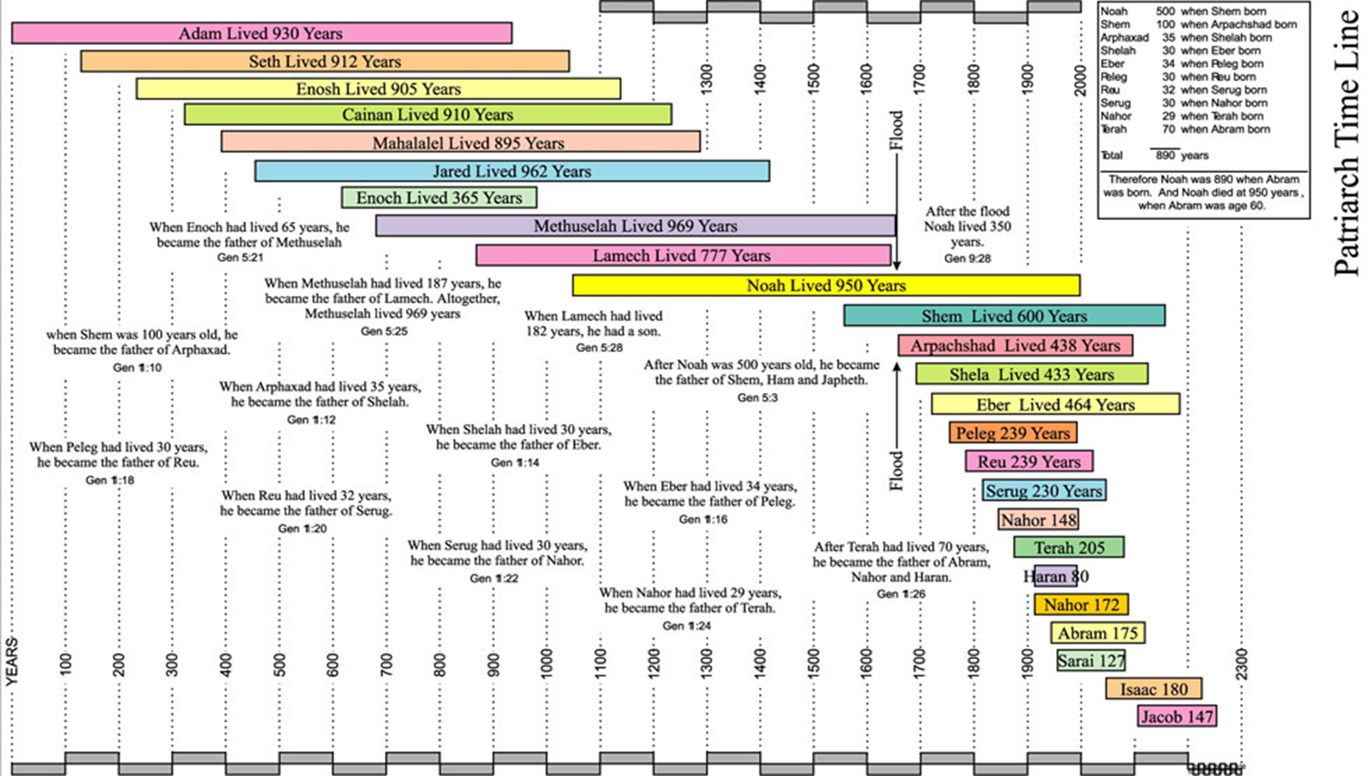

Slide 15
Biblical Timeline
4004 BC
2348 BC
2242 BC
1996 BC
33 A.D.
Today
Creation
Flood
Babel
Abraham
Christ
You
2000
2000
2000
6000 years

Slide 16
Is Genesis History?
Some would argue
Genesis is really just figurative, a type of Hebrew poetry
Genesis is really just conveying a deeper message about the attributes of God and His power

Slide 18
Hebrew vs English Poetry
English poetry is based on pronunciation and is presented based on parallelism of sound
Hebrew poetry is based on information and is presented based on parallelism of thought

Slide 19
Example of English Poetry
Do you like Green eggs and ham I do not like them, Sam-I-am. I do not like Green eggs and ham. Would you like them Here or there? I would not like them Here or there. I would not like them Anywhere.

Slide 20
Example of Hebrew Poetry
Psalm 104:29-30
29 You hide Your face, they are troubled;
You take away their breath, they die and return to their dust.
30 You send forth Your Spirit, they are created;
And You renew the face of the earth.

Slide 21
What is Genesis?
Genesis 4:8-9
Now Cain talked with Abel his brother; and it came to pass, when they were in the field, that Cain rose up against Abel his brother and killed him. Then the Lord said to Cain, “Where is Abel your brother?” He said, “I do not know. Am I my brother’s keeper?”

Slide 22
Poetry in Genesis
Genesis 4:23-24
23 Then Lamech said to his wives:
“Adah and Zillah, hear my voice;
Wives of Lamech, listen to my speech!
For I have killed a man for wounding me,
Even a young man for hurting me.
24 If Cain shall be avenged sevenfold,
Then Lamech seventy-sevenfold.

Slide 23
Poetry in Genesis
Genesis 4:23-24
23 Then Lamech said to his wives:
“Adah and Zillah, hear my voice;
Wives of Lamech, listen to my speech!
For I have killed a man for wounding me,
Even a young man for hurting me.
24 If Cain shall be avenged sevenfold,
Then Lamech seventy-sevenfold.

Slide 24
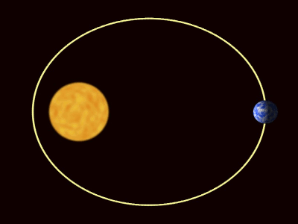
How do we Measure Years?
Astronomically: The Earth revolves around the Sun every 365 days

Slide 25
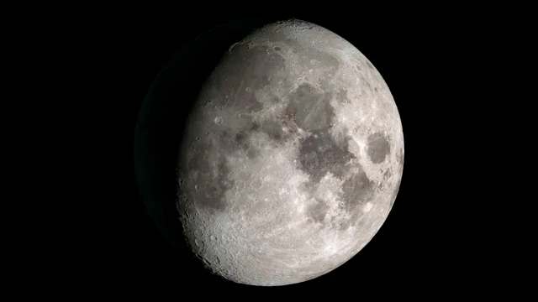
How do we Measure Months?
Astronomically: The Moon rotates on it’s axis every 29.5 days

Slide 26
How do we Measure Days?
Astronomically: The Earth rotates on it’s axis making a full rotation every 24 hours

Slide 27
What about the Week?
Genesis 2:2-3
And on the seventh day God ended His work which He had done, and He rested on the seventh day from all His work which He had done. Then God blessed the seventh day and sanctified it, because in it He rested from all His work which God had created and made.

Slide 28
Does all of this Really even Matter?

Slide 29
Christian Doctrines from Genesis
The Consequence of Sin & Death
Salvation
Marriage
Sanctity of Human Life
Sabbath
Racism
Origins
Modesty/Nakedness
Gender Roles

Slide 30
Scripture is its Own Best Interpreter
Multiple books (NT & OT) refer back to the people, places, and events of Genesis as history.
These people, places, and events had spiritual and theological consequences to Christianity
The consequences from Genesis have important implications and impact today

Slide 31
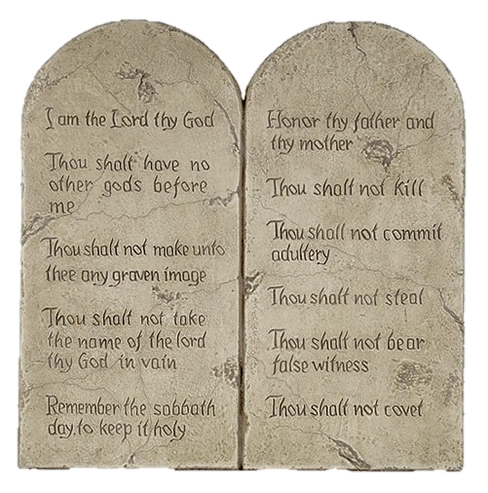
Exodus 20:11 - Sabbath
For in six days the Lord made the heavens and the earth, the sea, and all that is in them, and rested the seventh day. Therefore the Lord blessed the Sabbath day and hallowed it.

Slide 32
Exodus 31:16-17 - Sabbath
Therefore the children of Israel shall keep the Sabbath, to observe the Sabbath throughout their generations as a perpetual covenant. It is a sign between Me and the children of Israel forever; for in six days the Lord made the heavens and the earth, and on the seventh day He rested and was refreshed.

Slide 33
Isaiah 45:12 - Origins
I have made the earth, And created man on it. I—My hands—stretched out the heavens, And all their host I have commanded.

Slide 34
Isaiah 45:18 - Origins
For thus says the Lord, Who created the heavens, Who is God, Who formed the earth and made it, Who has established it, Who did not create it in vain, Who formed it to be inhabited: “I am the Lord, and there is no other

Slide 35
Isaiah 54:9-10 - Origins
“For this is like the waters of Noah to Me; For as I have sworn That the waters of Noah would no longer cover the earth, So have I sworn That I would not be angry with you, nor rebuke you. For the mountains shall depart And the hills be removed, But My kindness shall not depart from you, Nor shall My covenant of peace be removed,” Says the Lord, who has mercy on you.

Slide 36
Luke 3:23-38 - Origins
Now Jesus Himself began His ministry at about thirty years of age, being (as was supposed) the son of Joseph, the son of Heli, the son of Matthat, the son of Levi, the son of Melchi, the son of Janna, the son of Joseph, ………the son of Shem, the son of Noah, the son of Lamech, the son of Methuselah, the son of Enoch, the son of Jared, the son of Mahalalel, the son of Cainan, the son of Enosh, the son of Seth, the son of Adam, the son of God.

Slide 37
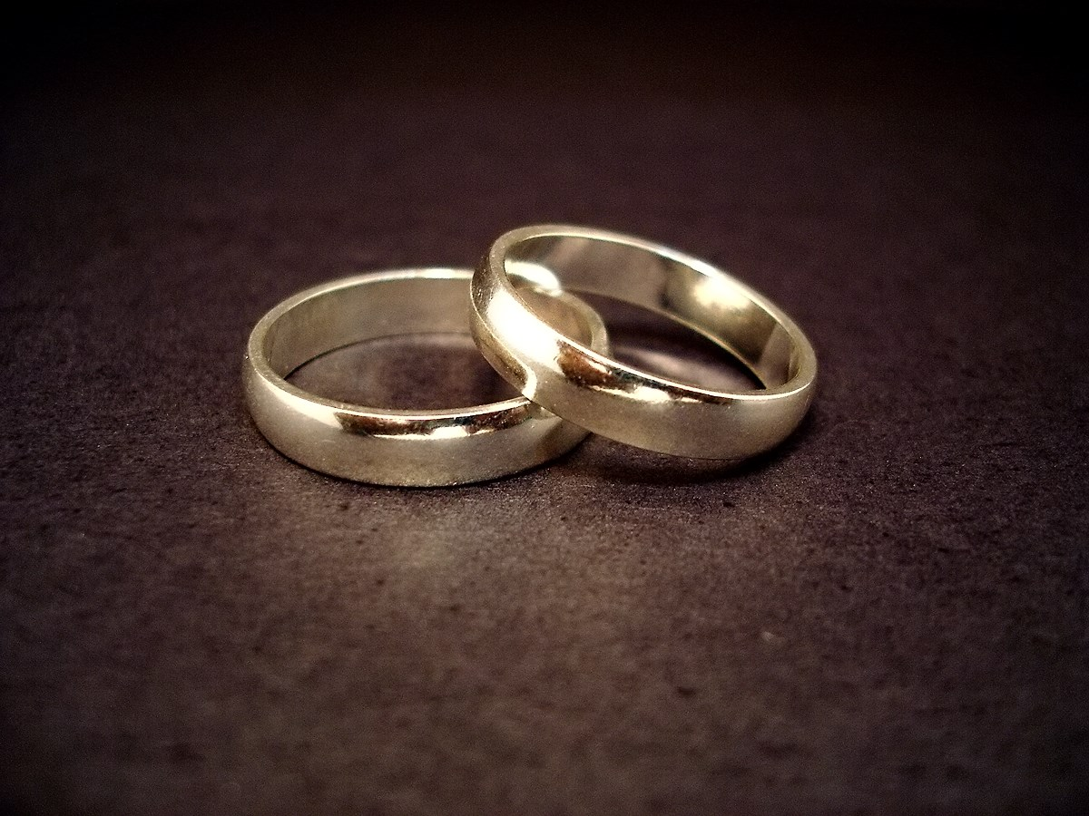
Mark 10:5-9 - Marriage
And Jesus answered and said to them, “Because of the hardness of your heart he wrote you this precept. But from the beginning of the creation, God ‘made them male and female.’ ‘For this reason a man shall leave his father and mother and be joined to his wife, and the two shall become one flesh’; so then they are no longer two, but one flesh. Therefore what God has joined together, let not man separate.”

Slide 38
Luke 17:22-27 - Origins
Then He said to the disciples, “The days will come when you will desire to see one of the days of the Son of Man, and you will not see it. And they will say to you, ’Look here!’ or ‘Look there!’ Do not go after them or follow them. For as the lightning that flashes out of one part under heaven shines to the other part under heaven, so also the Son of Man will be in His day. But first He must suffer many things and be rejected by this generation. And as it was in the days of Noah, so it will be also in the days of the Son of Man: They ate, they drank, they married wives, they were given in marriage, until the day that Noah entered the ark, and the flood came and destroyed them all.

Slide 39
Romans 5:12-14 – Consequence of Sin
Therefore, just as through one man sin entered the world, and death through sin, and thus death spread to all men, because all sinned— (For until the law sin was in the world, but sin is not imputed when there is no law. Nevertheless death reigned from Adam to Moses, even over those who had not sinned according to the likeness of the transgression of Adam, who is a type of Him who was to come

Slide 40
1 Corinthians 15:20-22 - Resurrection
But now Christ is risen from the dead, and has become the firstfruits of those who have fallen asleep. For since by man came death, by Man also came the resurrection of the dead. For as in Adam all die, even so in Christ all shall be made alive.

Slide 41
1 Timothy 2:11-15 – Gender Roles
Let a woman learn in silence with all submission. And I do not permit a woman to teach or to have authority over a man, but to be in silence. For Adam was formed first, then Eve. And Adam was not deceived, but the woman being deceived, fell into transgression. Nevertheless she will be saved in childbearing if they continue in faith, love, and holiness, with self-control.

Slide 42
Hebrews 11:3-7 - Origin
By faith Abel offered to God a more excellent sacrifice than Cain, through which he obtained witness that he was righteous, God testifying of his gifts; and through it he being dead still speaks. By faith Enoch was taken away so that he did not see death, “and was not found, because God had taken him”; for before he was taken he had this testimony, that he pleased God. But without faith it is impossible to please Him, for he who comes to God must believe that He is, and that He is a rewarder of those who diligently seek Him. By faith Noah, being divinely warned of things not yet seen, moved with godly fear, prepared an ark for the saving of his household, by which he condemned the world and became heir of the righteousness which is according to faith.

Slide 43
1 Peter 3:20 - Salvation
who formerly were disobedient, when once the Divine longsuffering waited in the days of Noah, while the ark was being prepared, in which a few, that is, eight souls, were saved through water. There is also an antitype which now saves us—baptism (not the removal of the filth of the flesh, but the answer of a good conscience toward God), through the resurrection of Jesus Christ,

Slide 44
2 Peter 3:1-7 - Origins
Beloved, I now write to you this second epistle (in both of which I stir up your pure minds by way of reminder), that you may be mindful of the words which were spoken before by the holy prophets, and of the commandment of us, the apostles of the Lord and Savior, knowing this first: that scoffers will come in the last days, walking according to their own lusts, and saying, “Where is the promise of His coming? For since the fathers fell asleep, all things continue as they were from the beginning of creation.” For this they willfully forget: that by the word of God the heavens were of old, and the earth standing out of water and in the water, by which the world that then existed perished, being flooded with water. But the heavens and the earth which are now preserved by the same word, are reserved for fire until the day of judgment and perdition of ungodly men.

Slide 45
Morality
Racism
Abortion
Homosexuality
Transgenderism
Modesty/Nakedness
Environmentalism
Climate Change

Slide 46
Racism
Genesis 3:20
And Adam called his wife’s name Eve, because she was the mother of all living.

Slide 47
Racism
Acts 17:26
And He has made from one blood every nation of men to dwell on all the face of the earth, and has determined their preappointed times and the boundaries of their dwellings

Slide 48
Abortion
Genesis 1:26
Then God said, “Let Us make man in Our image, according to Our likeness

Slide 49
Homosexuality
Genesis 2:24
Therefore a man shall leave his father and mother and be joined to his wife, and they shall become one flesh.

Slide 50
Transgenderism
Genesis 1:27
So God created man in His own image; in the image of God He created him; male and female He created them.

Slide 51
Modesty/Nakedness
Genesis 3:6-7
So when the woman saw that the tree was good for food, that it was pleasant to the eyes, and a tree desirable to make one wise, she took of its fruit and ate. She also gave to her husband with her, and he ate. Then the eyes of both of them were opened, and they knew that they were naked; and they sewed fig leaves together and made themselves coverings.

Slide 52
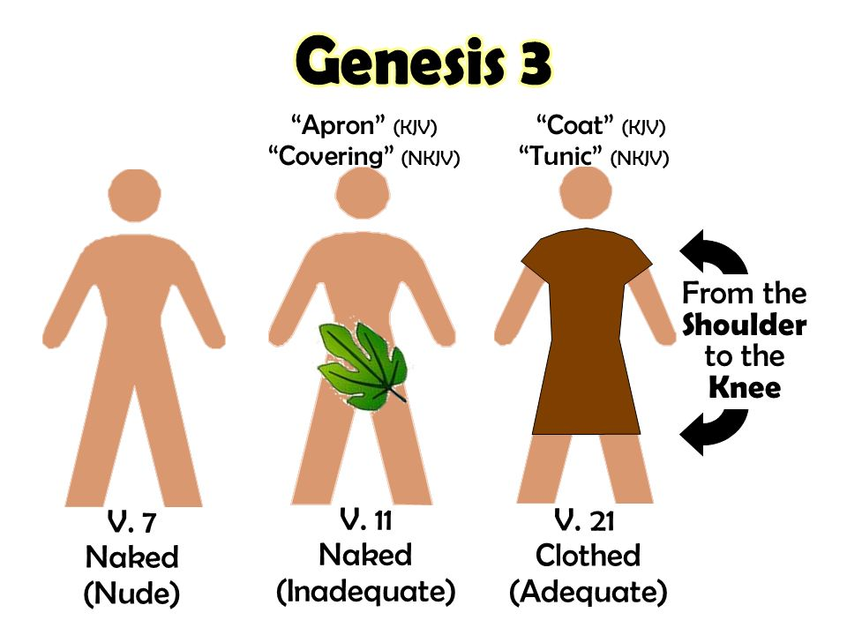
Modesty/Nakedness
Genesis 3:21
Also for Adam and his wife the Lord God made tunics of skin, and clothed them.

Slide 53
Environmentalism
Genesis 1:28
Then God blessed them, and God said to them, “Be fruitful and multiply; fill the earth and subdue it; have dominion over the fish of the sea, over the birds of the air, and over every living thing that moves on the earth.”

Slide 54
Climate Change
Genesis 8:22
“While the earth remains, Seedtime and harvest, Cold and heat, Winter and summer, And day and night Shall not cease.”

Slide 55
Overview
Different Views on Genesis
Biblical Reasons for a Young Earth and Historical Narrative of Genesis
Common Objections to a Literal Interpretation of Genesis Answered

Slide 56
Day Age Theory
Idea that “day” in Genesis means “ages” or “epochs”
Hebrew word “yōm” has different meanings depending on context
One meaning is a long but finite period of time

Slide 57
Passages out of Context
Psalm 90:4
For a thousand years in Your sight Are like yesterday when it is past, And like a watch in the night.
2 Peter 3:8
But, beloved, do not forget this one thing, that with the Lord one day is as a thousand years, and a thousand years as one day.

Slide 58
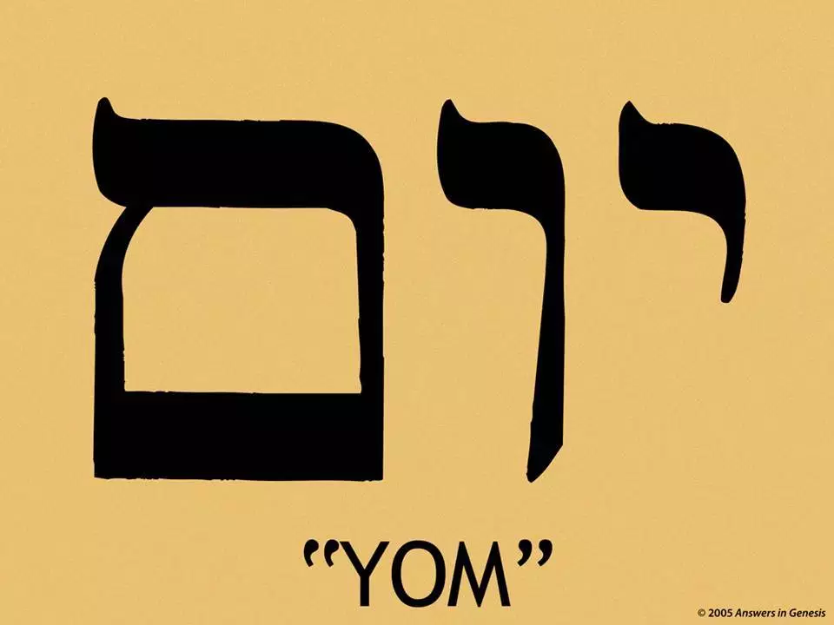
Hebrew Word: Yōm
Has different meanings based on context.
1 Chronicles 5:10
“Now in the days of Saul…”
Joel 2:1
“…For the day of the Lord is coming…”

Slide 59
Context Matters
When “yōm” is used with a number in a list…first day, second day, third day,…it always means a 24 hour day
When used with the phrase “morning” and “evening”
This expression is used 23 times in the OT. Every instance refers to ordinary 24 hour days.
When “day” is contrasted with “night”, 50 times outside Genesis 1

Slide 60
Genesis 1:5
God called the light Day, and the darkness He called Night. So the evening and the morning were the first day.

Slide 61
Genesis 1:5
God called the light Day, and the darkness He called Night. So the evening and the morning were the first day.

Slide 62
Genesis 1:5
God called the light Day, and the darkness He called Night. So the evening and the morning were the first day.

Slide 63
Genesis 1:5
God called the light Day, and the darkness He called Night. So the evening and the morning were the first day.

Slide 64
Framework Theory
This theory states that days 1-3 can be parallel with days 4-6. The first three represent “filling” and the last three represent “forming”.
Notes:
Theory came about in 1924 by Arie Noortzij, it was popularized in the 50s by Meredith Kline. It is currently one of the more popular views being advocated particularly in academic circles.
Parallelism requires symmetry and the total account of creation is written in 7 days.
Heavenly light bearers were put in the heavens on day 4 but the heavens were not made until day 2.
Water was created on day 1 not day 2. The oceans were compiled on day 3 and water animals were created on day 5.
The days of creation make chronological sense when read literally in order, but when rearranged to fit a concocted view of scripture they are nonsensical.
Even if true, this would make Genesis 1-2 figurative but what about the rest of Genesis 1-11 which still doesn’t fit the secular view? Where is the parallelism in chapter 5 with the genealogies that start with Adam?

Slide 65
Gap Theory
This theory states that there was a large gap or time span between Genesis 1:1 and 1:2. The Earth and Universe were created long ago and then recreated in the six day creation account.
Notes:
Popularized by the Scofield Reference Bible in 1909
This theory lacks and textual evidence or Biblical support and is purely the result of trying to fit billions of years into the text.
This theory doesn’t even harmonize the secular science views because most dating methods date sedimentary rocks that would have formed after the Earth was created up to 500 million years ago.
Why are there so many varying theories trying to fit millions of years into the text? Most came around in the past few centauries yet even old earth advocates don’t agree on which is right.

Slide 66
Recap
Young Earth Creationism vs Old Earth Creationism
Biblical Reasons for a Young Earth and Historical Narrative of Genesis
Common Objections to a Literal Interpretation of Genesis Answered

Slide 67
Conclusion
Genesis is written as historical narrative. The people, places, and events recorded are treated as real and true historical events. By adding up all the genealogies from Adam to Christ to today we get an age of about 6000 years. The book is referenced directedly and indirectly by multiple Bible writers in both the old and new testament. Genesis is critical to understanding key doctrines in the Bible.

