Slide 1
Paden Reed, M.S.

Slide 2
Overview
The Atheists Challenge
Suffering Exists
World Religions and Suffering
The Christian Response
Ways We Benefit from Suffering

Slide 3
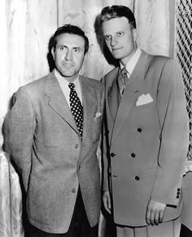
The Life of a Former Preacher
Charles Templeton (1915 – 2001)
Was a preacher alongside Billy Graham speaking to crowds between 10 and 30 thousand nightly
Considered one of the most prolific and well known preachers of the 20th century
Notes:
Youth for Christ Rallies

Slide 4
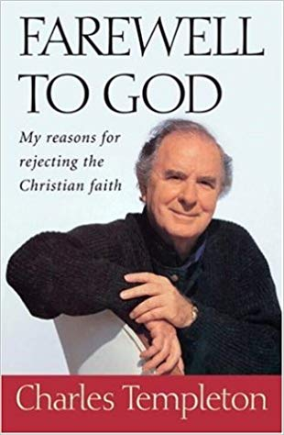
The Life of a Former Preacher
Lee Strobel interviewed Charles Templeton shortly after he published his book “Farewell to God” and before his death in 2001.
Strobel: “Was there one thing in particular that caused you to lose your faith in God?”
1996
Notes:
Reference: Case for Faith – Lee Strobel

Slide 5
Templeton: “It was a photograph in Life magazine…it was a picture of a black woman in Northern Africa. They were experiencing a devasting drought and she was holding her dead baby in her arms and looking up to heaven with the most forlorn expression. I looked at it and I thought, Is it possible to believe that there is a loving or caring creator when all this woman needed was rain? ”

Slide 6
Templeton: “…That was the climatic moment, and then I began to think further about the world being the creation of God. I started considering the plagues that sweep across parts of the planet and indiscriminately kill – more often than not, painfully – all kinds of people, the ordinary, the decent, and the rotten. And it just became crystal clear to me that it is not possible for an intelligent person to believe that there is a deity who loves. ”
Notes:
Tell story of Alex Wagenblast in Undergrad

Slide 7
The Atheists Challenge
The Bible claims that God is All-Powerful
Mathew 19:26
Job 42:2
Genesis 17:1
The Bible claims that God is All-Loving
1 John 4:8
John 3:16
Notes:
Genesis 17:1 – The Almighty – Hebrew: Shadday – God is most powerful

Slide 8
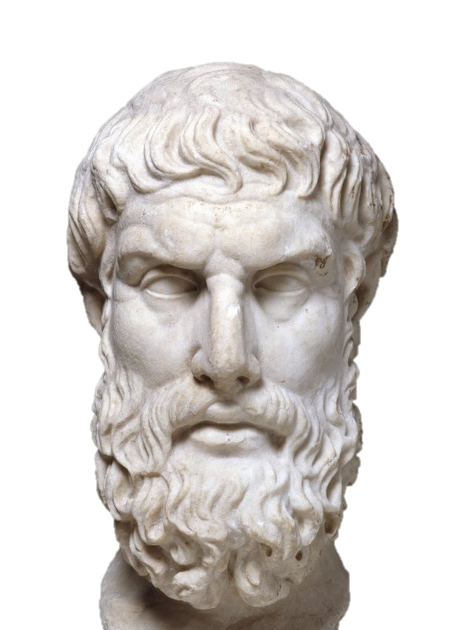
If God is willing to prevent evil but not able, then he is not all-powerful.
If He is able to prevent evil but not willing, then he is not good
But if he is both willing and able, how can evil exist?
If He is neither able nor willing, why call Him God?
Epicurus
341 BC – 270 BC
Notes:
Epicurus was an ancient Greek philosopher and sage who founded a highly influential school of philosophy now called Epicureanism

Slide 9
The Atheists Challenge
Premise 1: If an all-loving and all-powerful God exists, then evil, pain, and suffering cannot exist.
Premise 2: Evil, pain, and suffering do exist.
Conclusion: God does not exist

Slide 10
Overview
The Atheists Challenge
Suffering Exists
World Religions and Suffering
The Christian Response
Ways We Benefit from Suffering

Slide 11
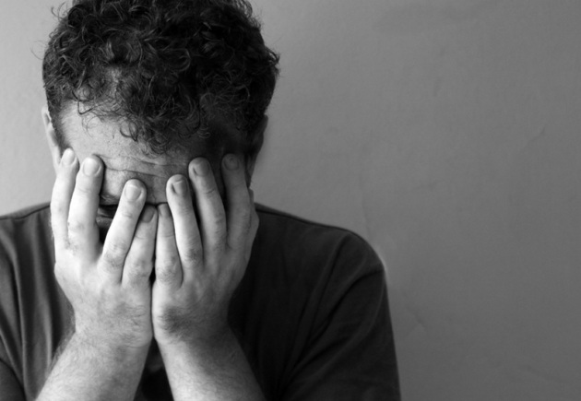
Suffering Exists
Natural Disasters
Man’s Inhumanity to Man
Apparent Uncaused Suffering

Slide 12
Natural Disasters
1556 – Shaanxi earthquake struck China – 830,000
1815 – Volcanic explosion of Mt. Tambora, Indonesia – 92,000
1887 – Flooding in Hunan Province, China – 2,000,000
1918 – Global Flu – 50 million
1970 – Bhola cyclone in Bangladesh – 500,000
2003 – European heat wave – 70,000
2004 – Tsunami in Indonesia – 230,000
2020 – COVID 19 – 1,000,000?

Slide 13
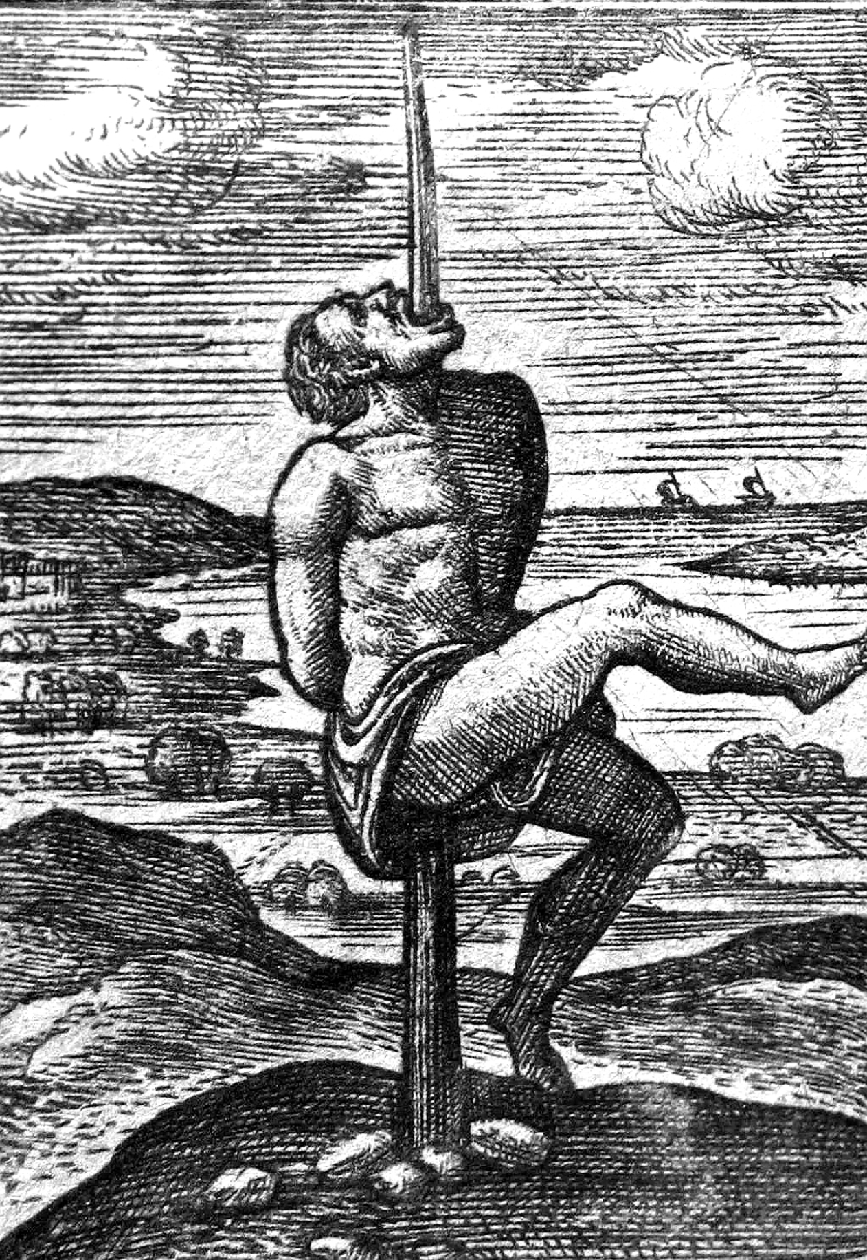
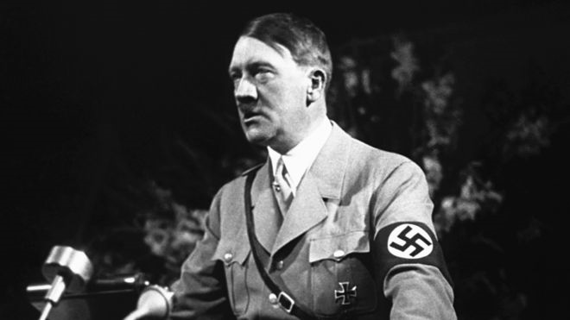
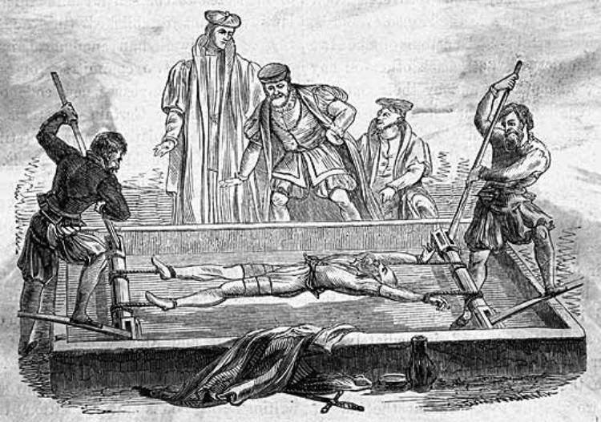
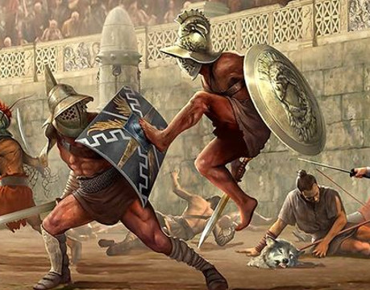
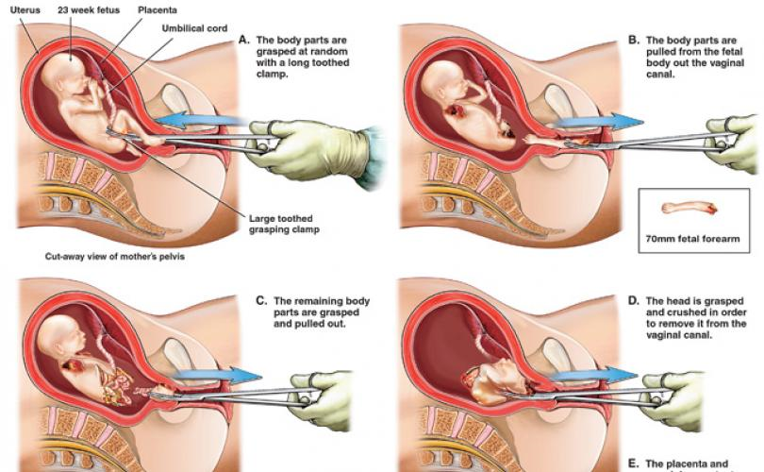
Man’s Inhumanity to Man
Notes:
Ukujola, echelle

Slide 14
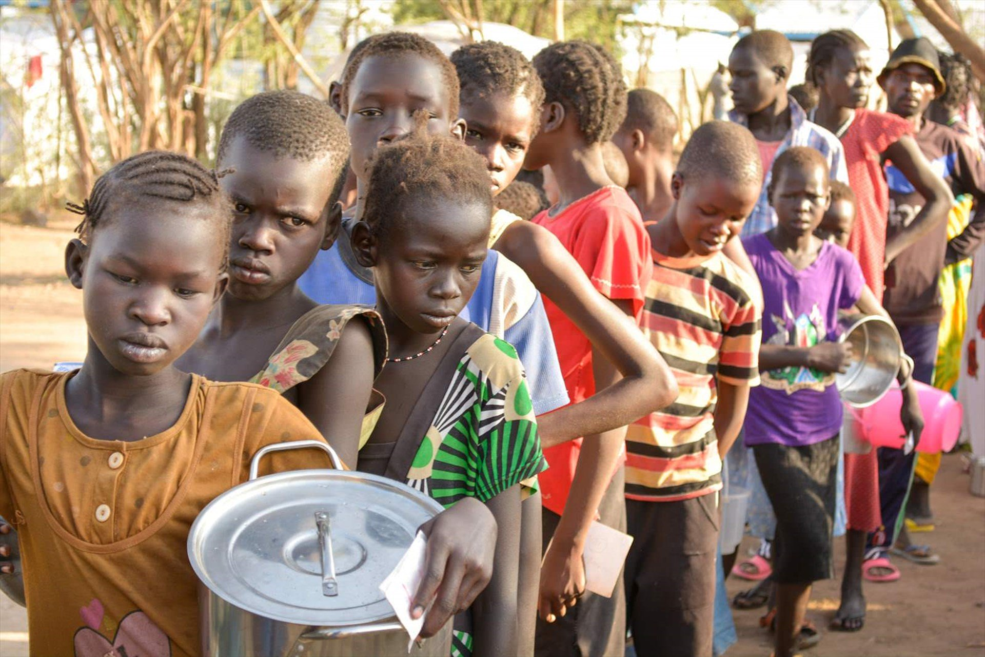
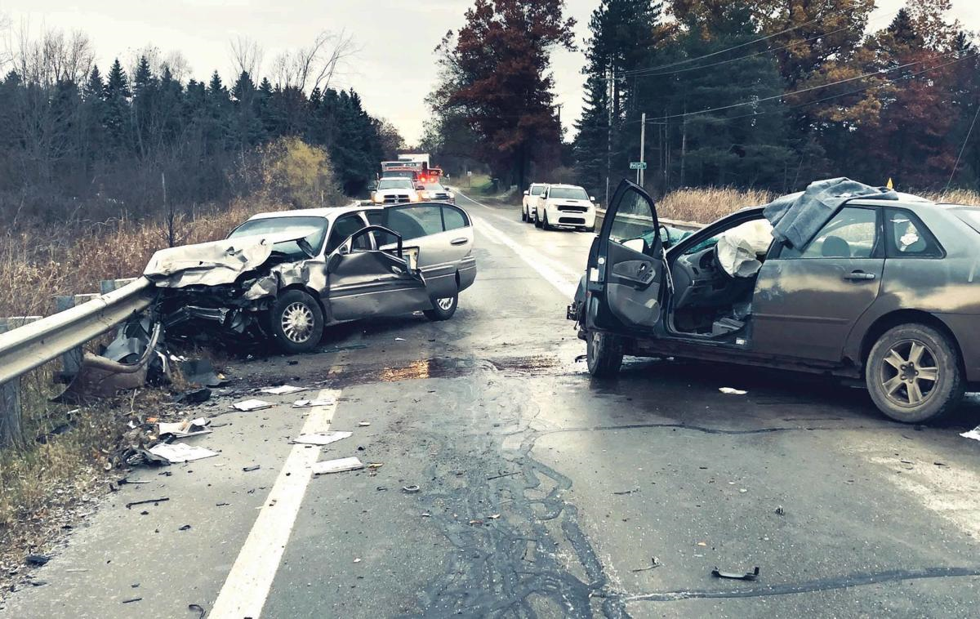
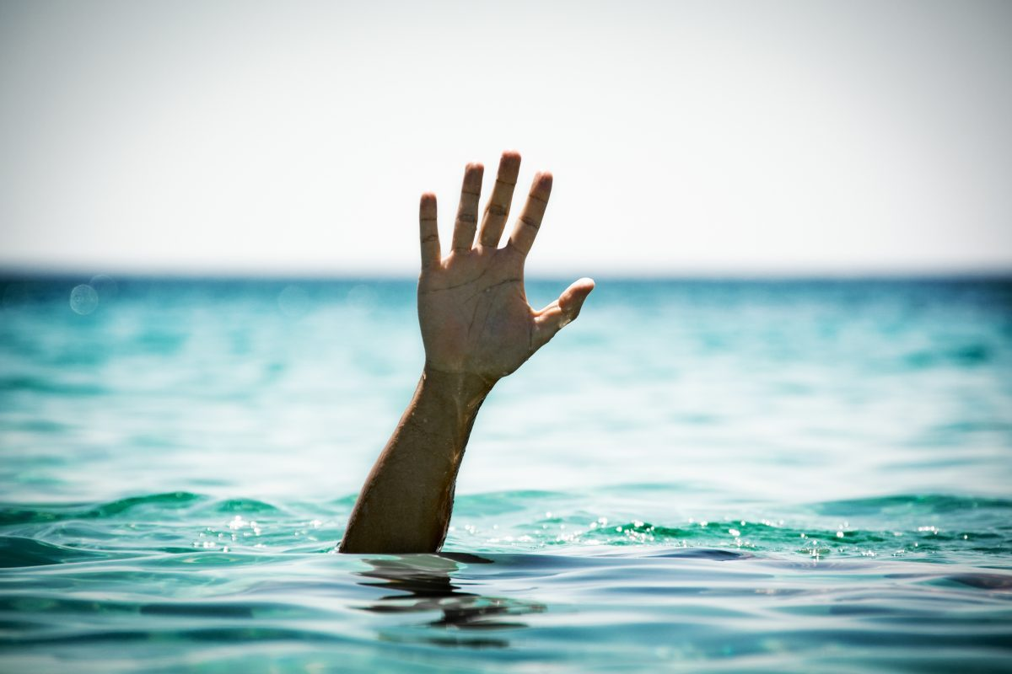
Apparent Uncaused Suffering
Notes:
Personal Story, miscarriage

Slide 15
Overview
The Atheists Challenge
Suffering Exists
World Religions and Suffering
The Christian Response
Ways We Benefit from Suffering

Slide 16
World Religions and Suffering
Atheism
Astrology, Fortunetelling, Fatalism
Buddhism, Hinduism, New Age
Islam

Slide 17
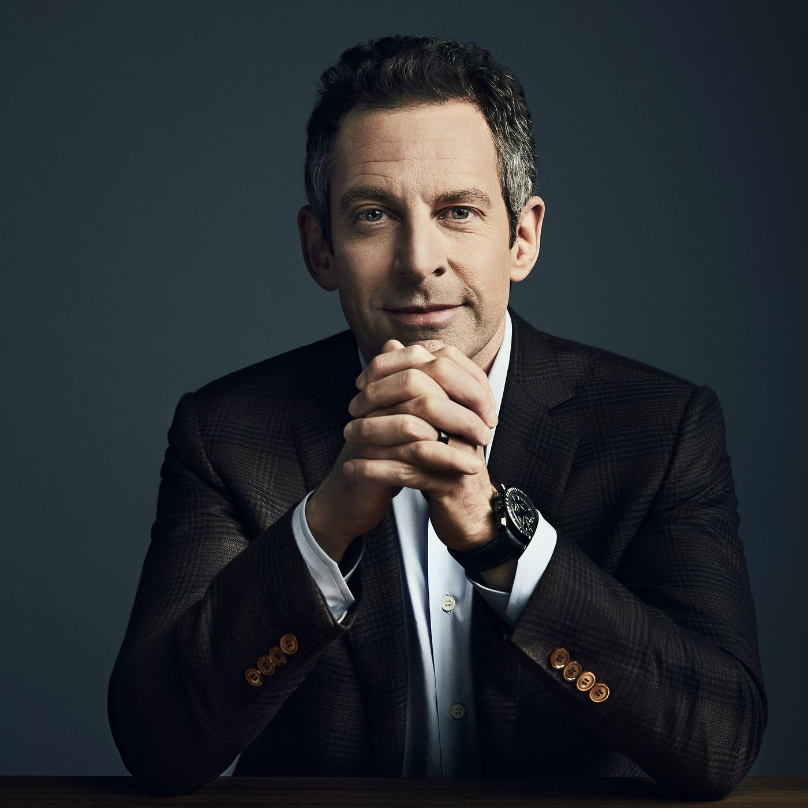
Atheism
“Free will is an illusion. Our wills are simply not of our own making…We do not have the freedom we think we have…I cannot determine my wants….My mental life is given to me by the cosmos”
Free Will, 2012
Sam Harris

Slide 18
Astrology, Fortunetelling, Fatalism
Our fate is written in the stars or in a crystal ball
Closely tied to the Atheist view of predeterminism and materialism
It’s just a scam….
Notes:
Horoscope

Slide 19
Buddhism, Hinduism, New Age
Existence is cyclical - Reincarnation
Suffering is the result of repeating life in an effort to get it right.
Problem is “right” is not truly defined and we don’t know our past experiences to “get it right”. So current suffering is meaningless in correcting our future lives…if it were true

Slide 20
Islam
2 Reasons: Sin or a Test
Surah 42:30
And whatever strikes you of disaster - it is for what your hands have earned; but He pardons much.

Slide 21
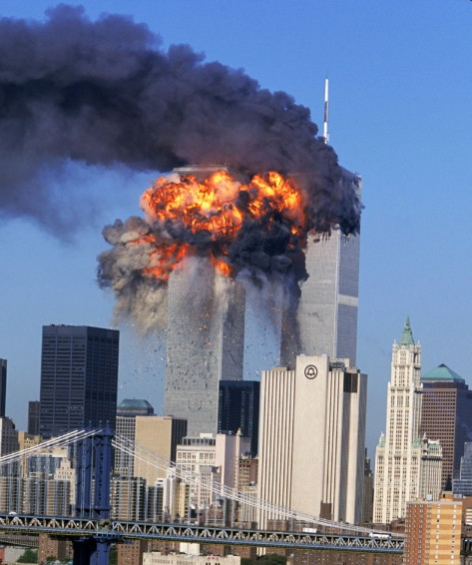
Islam
2 Reasons: Sin or a Test
Surah 47:4
So when you meet those who disbelieve [in battle], strike [their] necks until, when you have inflicted slaughter upon them, then secure their bonds, and either [confer] favor afterwards or ransom [them] until the war lays down its burdens.

Slide 22
Islam
2 Reasons: Sin or a Test
Surah 47:4
That [is the command]. And if Allah had willed, He could have taken vengeance upon them [Himself], but [He ordered armed struggle] to test some of you by means of others. And those who are killed in the cause of Allah - never will He waste their deeds.

Slide 23
Overview
The Atheists Challenge
Suffering Exists
World Religions and Suffering
The Christian Response
Ways We Benefit from Suffering

Slide 24
The Christian Response
Evil, Pain, and Suffering
Intellectual
Emotional
Logical
Probable

Slide 25
What about Evil?
If an atheist admits that there is evil then he must both define it and explain its origin.
This in turn leads to the moral dilemma of accounting for Atheism

Slide 26
Anthropological Argument
1. If God does not exist, then objective morals do not exist.
2. Objective moral values such as good and evil, justice and injustice, do exist.
3. Therefore, God exits.

Slide 27
The Christian Response
Pain and Suffering
Intellectual
Emotional
Logical
Probable

Slide 28
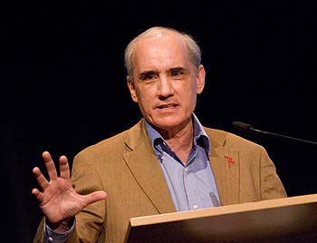
Atheists Accept Some Suffering
“You can’t get through life without some harm. I think we all agree it is wrong to stick a needle into a baby. That’s horrible. But, if that baby needs a life-saving injection, we will cause that harm…The baby won’t understand it, but we will do that because there is a greater good”
Butt/Barker Debate
Dan Barker

Slide 29
The Christian Response
Unnecessary Pain and Suffering
Intellectual
Emotional
Logical
Probable

Slide 30
Is it logical for Suffering and God to Coexist?
An all-loving, all-powerful God exists
Unnecessary Suffering Exists
Where is the explicit contradiction in these two statements?

Slide 31
Hidden Assumptions
If God is all-powerful, He can create any world that He wants
If God is all-loving, He prefers a world without suffering

Slide 32
Can God Create Any World He Wants?
No, there are certain things which are logically inconsistent and violate the very nature of truth.
Notes:
God is truth, and truth cannot contradict
We have free will, it is logically impossible to make someone do something freely

Slide 33
Can God Create Any World He Wants?
If an Atheist insists that God can or should be able to do the impossible…then there should be no issue with an Atheist accepting what he perceives as an impossibility.

Slide 34
Does an All-Loving God Prefer no Suffering?
How could we know without having all knowledge?
We have already shown that some suffering is beneficial.
Who is to say that not all suffering in some form or fashion has some reason for God allowing it in this world?
Notes:
Just because we don’t or an atheist does not see a point to suffering does not mean that God does not have a reason for that suffering.

Slide 35
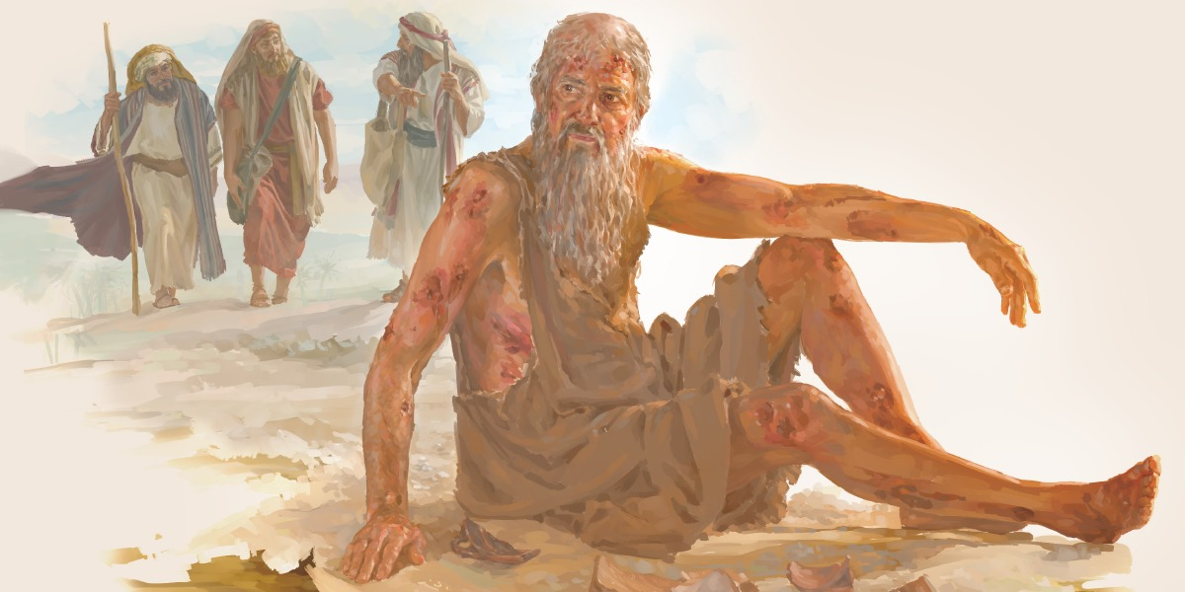
Job
Job had everything – friends, family, land, cattle, etc.
Everything taken away from him
Afflicted with sores
Left by his wife
Rejected by his friends

Slide 36
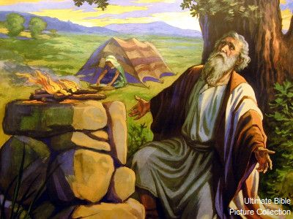
Job 1:8
Then the Lord said to Satan, “Have you considered My servant Job, that there is none like him on the earth, a blameless and upright man, one who fears God and shuns evil?”

Slide 37
Job 38:1-5
Then the Lord answered Job out of the whirlwind, and said:
“Who is this who darkens counsel
By words without knowledge?
Now prepare yourself like a man;
I will question you, and you shall answer Me.
“Where were you when I laid the foundations of the earth?
Tell Me, if you have understanding.
Who determined its measurements?
Surely you know!

Slide 38
Is it logical for Suffering and God to Coexist?
An all-loving, all-powerful God exists
Unnecessary Suffering Exists
Where is the explicit contradiction in these two statements?

Slide 39
The Atheist have the Burden of Proof
It’s logically impossible that free will exists
It’s logically impossible that God has good reasons for permitting suffering

Slide 40
The Christian Response
Unnecessary Pain and Suffering
Intellectual
Emotional
Logical
Probable

Slide 41
The Probable Problem
While it’s logically possible that God and suffering both exist, it’s far from likely
Because there is so much suffering, it seems improbably that God could have good reasons for permitting it
So while it is not impossible that God exists it is highly improbable

Slide 42
The Probable Problem
We are not in a position to say that God probably lacks reasons for allowing suffering in the world…because we are not all knowing.
This argument must also be weighed in light of all the previous arguments made FOR the existence of God
The Christian faith gives the best explanation of the co-existence of God and Suffering

Slide 43
The Christian Response
Unnecessary Pain and Suffering
Intellectual
Emotional
Logical
Probable

Slide 44
Overview
The Atheists Challenge
Suffering Exists
World Religions and Suffering
The Christian Response
Ways We Benefit from Suffering

Slide 45
Benefits from Suffering
Keeps the World from Becoming too Attractive
Brings out our Best
Makes us more Appreciative
Makes us more dependent on God
Teaches us how to Pray

Slide 46
Attractiveness of the World
1 Peter 2:11
Hebrews 13:14
2 Corinthians 4:16-18
2 Corinthians 5:1-8
Question: Is it easy to get caught up in the cares of this world? Chasing fame, fortune, experiences, etc.

Slide 47
Brings out our Best
James 1:2-4
2 Corinthians 4:16-18
Job
Question: How has suffering brought out the best in you?
Notes:
Ex of brother, atheist

Slide 48
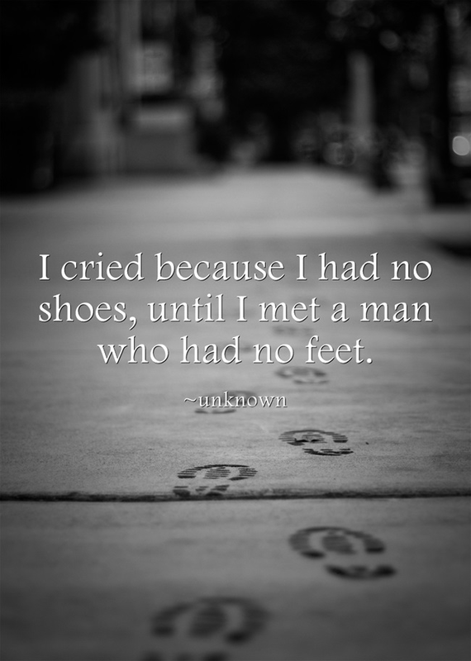
Makes us more Appreciative
Philippians 1:3-8
Notes:
We can’t truly appreciate the peaks until we have been in the valley

Slide 49
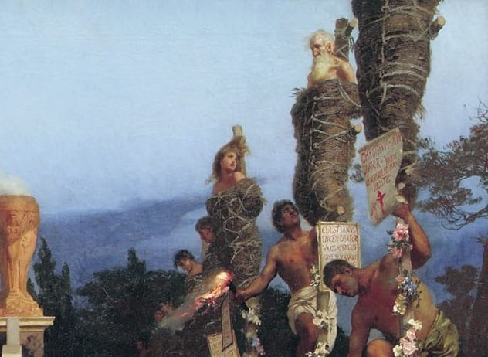
Makes us more Dependent on God
Psalm 27:4-5

Slide 50
Teaches us how to Pray
Acts 16:22-25
Question: Do you think to pray more when things are going great or when things are going bad?

Slide 51
Benefits from Suffering
Keeps the World from Becoming too Attractive
Brings out our Best
Makes us more Appreciative
Makes us more dependent on God
Teaches us how to Pray

Slide 53
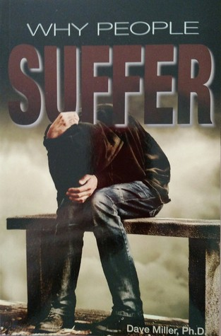
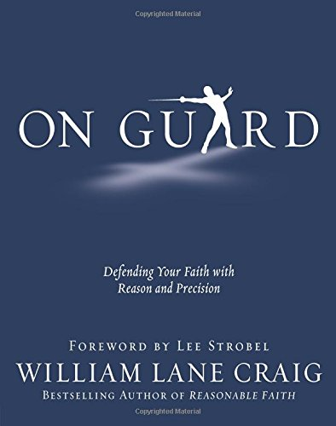
Recommended Resource

