Slide 1
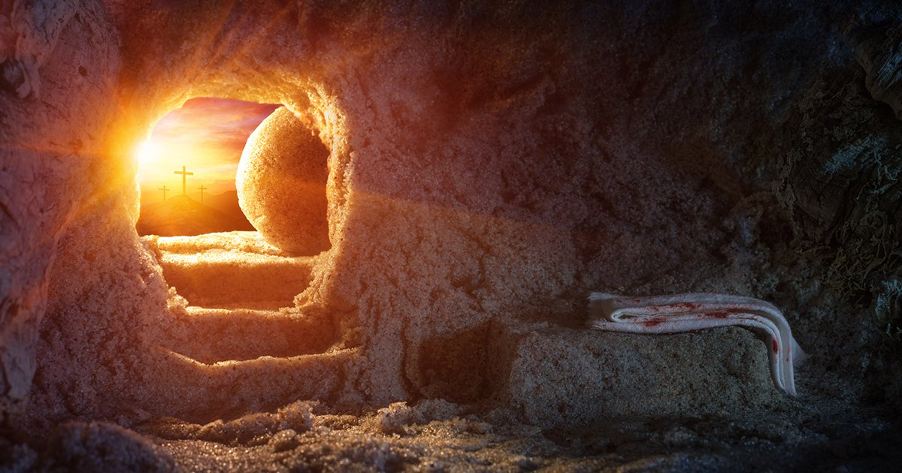
I am the Resurrection and the Life
Paden Reed, M.S.

Slide 2
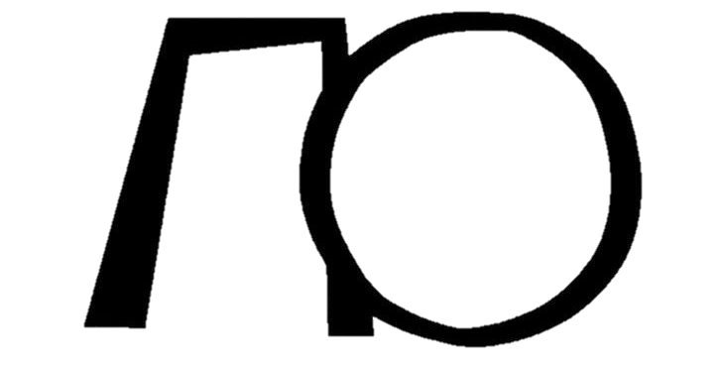
John 11:25
Jesus said to her, “I am the resurrection and the life. He who believes in Me, though he may die, he shall live. And whoever lives and believes in Me shall never die. Do you believe this?”.
Notes:
Jesus speaking to Martha, sister of Lazarus

Slide 3
Overview
The Importance of the Resurrection
The Historicity of Christ
The Authenticity of Scripture
Who was Jesus?
The Resurrection
Application

Slide 4
The Importance of the Resurrection
Atheist
Buddhist
Hindu
Muslim
Jew

Slide 5
Acts 4:10-11
let it be known to you all, and to all the people of Israel, that by the name of Jesus Christ of Nazareth, whom you crucified, whom God raised from the dead, by Him this man stands here before you whole. This is the ‘stone which was rejected by you builders, which has become the chief cornerstone.’
Salvation
Prayer
Grace
Morality
Faith
Heaven
Baptism

Slide 6
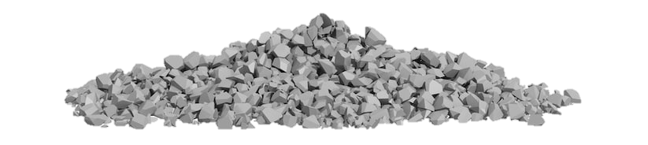
Acts 4:10-11
let it be known to you all, and to all the people of Israel, that by the name of Jesus Christ of Nazareth, whom you crucified, whom God raised from the dead, by Him this man stands here before you whole. This is the ‘stone which was rejected by you builders, which has become the chief cornerstone.’
Salvation
Prayer
Grace
Morality
Faith
Heaven
Baptism

Slide 7
1 Corinthians 15:12-19
Now if Christ is preached that He has been raised from the dead, how do some among you say that there is no resurrection of the dead? But if there is no resurrection of the dead, then Christ is not risen. And if Christ is not risen, then our preaching is empty and your faith is also empty.

Slide 8
1 Corinthians 15:12-19
Yes, and we are found false witnesses of God, because we have testified of God that He raised up Christ, whom He did not raise up—if in fact the dead do not rise. For if the dead do not rise, then Christ is not risen.

Slide 9
1 Corinthians 15:12-19
And if Christ is not risen, your faith is futile; you are still in your sins! Then also those who have fallen asleep in Christ have perished. If in this life only we have hope in Christ, we are of all men the most pitiable.

Slide 10
John 11:25
Jesus said to her, “I am the resurrection and the life. He who believes in Me, though he may die, he shall live. And whoever lives and believes in Me shall never die. Do you believe this?”

Slide 11
Overview
The Importance of the Resurrection
The Historicity of Christ
The Authenticity of Scripture
Who was Jesus?
The Resurrection
Application

Slide 12
The Historicity of Christ
If Christ never existed then He would have never died. If Christ never died then He would have never been resurrected.
In order to affirm the resurrection of Christ we must first affirm that He was a real person in history who lived during A.D. 1-33 in the region of Israel.

Slide 13
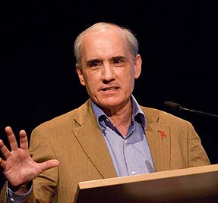
“The Gospel stories are no more historic than the Genesis creation accounts are scientific. They are filled with exaggerations, miracles, and admitted propaganda. They were written during a context of time when myths were being born, exchanged, elaborated, and corrupted, and they were written to an audience susceptible to such fables, They are cut from the same cloth as other religions and fables of the time. Taking all of this into account, it is rational to conclude that the New Testament Jesus is a myth.”
Dan Barker
(Losing Faith in Faith, 1992)

Slide 14
“Not only has the Divinity of Christ been given up, but his existence as a man is being more and more seriously questioned. Some of the ablest scholars of the world deny that he ever lived at all.”
Marshall J. Gauvin
(Did Jesus Really Live, 1995)
Notes:
Canadian Atheist

Slide 15
The Historicity of Christ
Roman Witnesses
Jewish Witnesses
Early Patristic Witnesses
Christian Witnesses

Slide 16
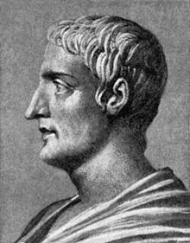
Tacitus
56 – 120 AD
Member of the Roman upper class with a formal education.
Held several high positions under emperors Nerva and Trajan.
Known for his work, Annals which documented the great fire of Rome during emperor Nero.

Slide 17
Tacitus
“Nero fabricated scapegoats – and punished with every refinement the notoriously depraved Christians (as they were popularly called). Their originator, Christ, had been executed in Tiberius’s reign by the governor of Judea, Pontius Pilatus. But in spite of this temporary setback the deadly superstition had broken out afresh, not only in Judea (where the mischief had started) but even in Rome.”

Slide 18
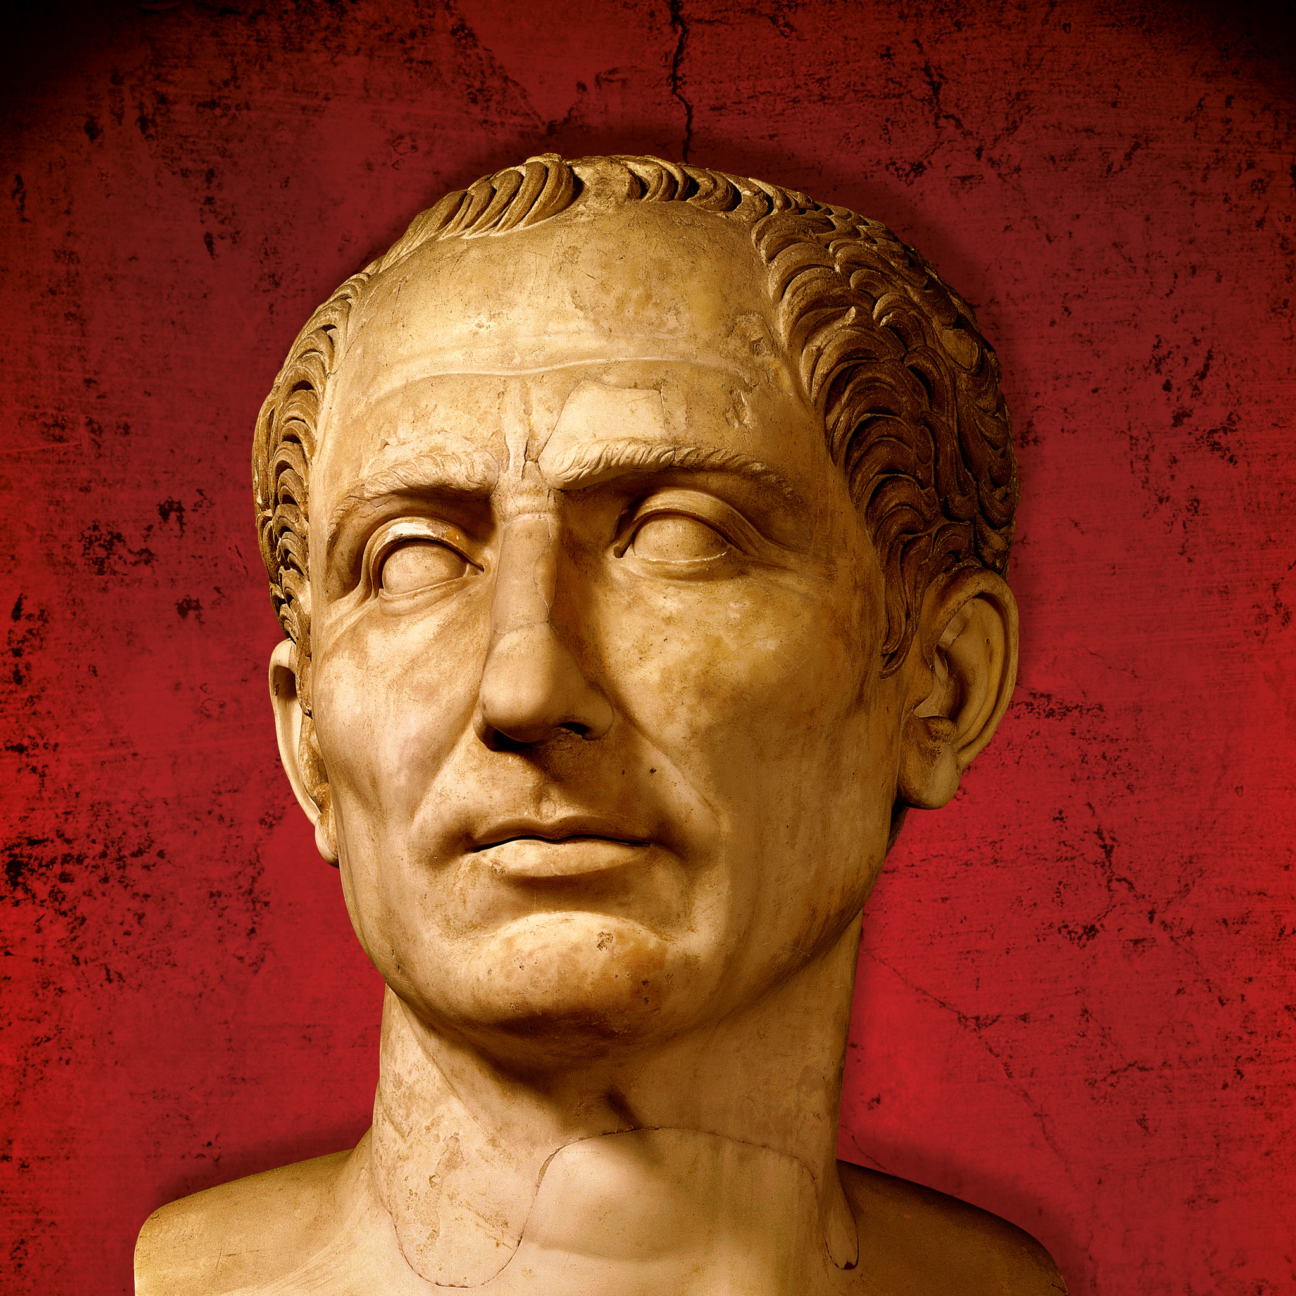
Suetonius
69 – 126 AD
Roman historian of the equestrian order
Known for the The Twelve Caesars which records the biographies of twelve roman rulers

Slide 19
Suetonius
“Because the Jews at Rome caused continuous disturbance at the instigation of Chrestus, he (Claudius) expelled them from the city…Punishments were also inflicted on the Christians, a sect professing a new and mischievous religious belief”
Notes:
Expulsion recorded in Acts 18:2
Chrestus is a misspelling of Christos which is the Greek word that translates the Hebrew word for messiah

Slide 20
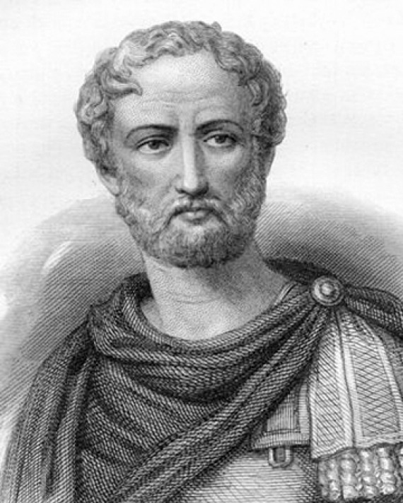
Pliny the Younger
61 – 113 AD
Lawyer, author, and magistrate
Wrote hundreds of letters of which 247 survived, collectively know as Letters
Wrote a letter to Emperor Trajan around 112 AD seeking counsel on dealing with Christians
Notes:
Uncle was Pliny the Elder who lived from AD23-79 and was the author of Natural History.

Slide 21
Pliny the Younger
“Having never been present at any trials of the Christians, I am unacquainted with the method and limits to be observed either in examining or punishing them…In the meanwhile, the method I have observed towards those who have been denounced to me as Christians is this: I interrogated them whether they were Christians; if they confessed it I repeated the question twice again, adding the threat of capital punishment; if they still persevered, I ordered them to be executed”
Notes:
From Letters

Slide 22
Pliny the Younger
“affirmed, however, the whole of their guilt, or their error, was, that they were in the habit of meeting on a certain fixed day before it was light, when they sang in alternate verses a hymn to Christ, as to a god, and bound themselves by a solemn oath, not to any wicked deeds…”
Notes:
Used the term Christian (s) 7x
Christ 3x

Slide 23
The Historicity of Christ
Roman Witnesses
Jewish Witnesses
Early Patristic Witnesses
Christian Witnesses

Slide 24
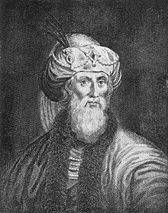
Josephus
37 – 100 AD
Born into a Jewish upper class priestly family
At age 19 he became a Pharisee
He later rebelled against Judaism and served under the Roman Empire
Wrote Antiquities of the Jews in 94 AD

Slide 25
Josephus
“And there arose about this time Jesus, a wise man, if indeed we should call him a man; for he was a doer of marvelous deeds, a teacher of men who receive the truth with pleasure. He led away many Jews, and also Greeks. This man was the Christ. And when Pilate had condemned him to the cross on his impeachment by the chief men among us…
Notes:
Every extant Greek manuscript contains the disputed portions and it also exists in Hebrew and Arabic versions

Slide 26
Josephus
“those who had loved him at first did not cease; for he appeared to them on the third day alive again, the divine prophets having spoken these and thousands of other wonderful things about him: and even now the tribe of Christians, so named after him, has not yet died out.”
Notes:
Every extant Greek manuscript contains the disputed portions and it also exists in Hebrew and Arabic versions

Slide 27
Josephus
“a man named James, the brother of Jesus who was called the Christ, and certain others. He (Ananus before the Sanhedrin) accused them of having transgressed the law, and condemned them to be stoned to death.”
Notes:
Later text in Antiquities of the Jews

Slide 28
The Historicity of Christ
Roman Witnesses
Jewish Witnesses
Early Patristic Witnesses
Christian Witnesses
Notes:
“Patristic Witnesses” were known as early Christian theologians. Essentially non inspired Christian writers.

Slide 29
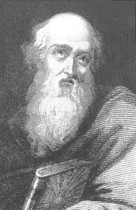
Polycarp
69 – 155 AD
Christian Bishop of Smyrna
Died a martyr, burned at the stake
Wrote letter to the Philippians

Slide 30
Polycarp
“I have greatly rejoiced with you in our Lord Jesus Christ, because you have followed the example of true love (as displayed by God)….and brings forth fruit to our Lord Jesus Christ, who for our sins suffered even unto death, whom God raised from the dead, having loosed the bands of the grave.”

Slide 31
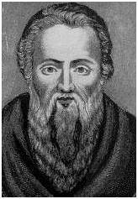
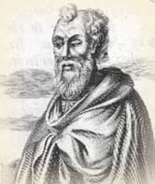
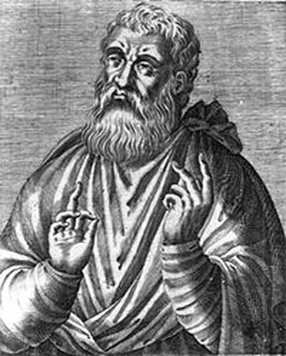
Patristic Witnesses
Ignatius
(35 – 108 AD)
Clement of Rome
(35 – 99 AD)
Justin Martyr
(100 – 165 AD)

Slide 32
The Historicity of Christ
Roman Witnesses
Jewish Witnesses
Early Patristic Witnesses
Christian Witnesses

Slide 33
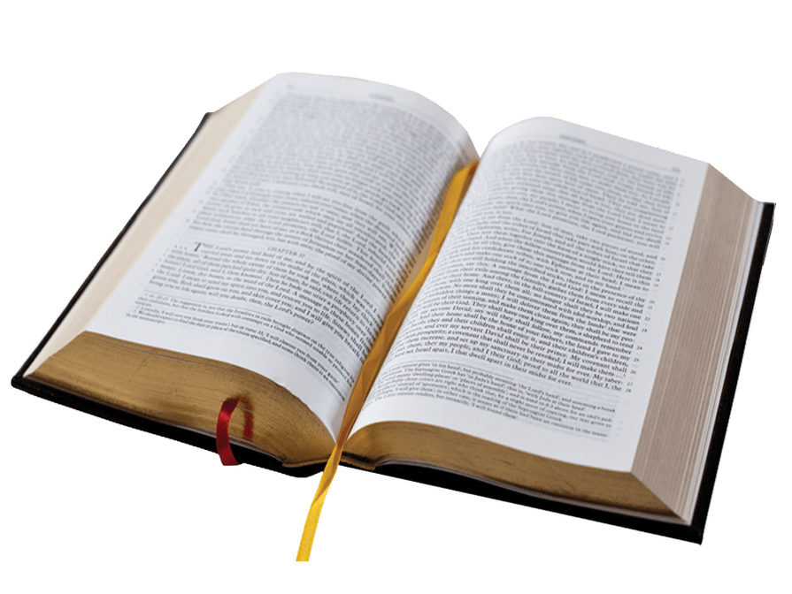
Christian Witnesses
Mathew
Mark
Luke
John
Paul
James
Peter
Jude

Slide 34
Overview
The Importance of the Resurrection
The Historicity of Christ
The Authenticity of Scripture
Who was Jesus?
The Resurrection
Application

Slide 35
The Authenticity of Scripture
The New Testament has been preserved
The translation process works
The New Testament is factually accurate

Slide 36
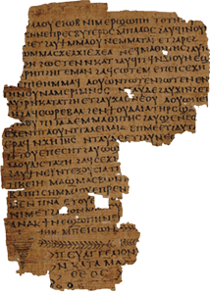
The New Testament Preserved
5,748 Greek Manuscripts Today (whole and partial)
Best Manuscripts date back to 350 AD
Codex Vaticanus
Codex Sinaiticus
Quotes from “Apostolic Fathers”.
Ancient Versions in various languages
Old Latin and Old Syriac (~250 AD)

Slide 37
NT vs Other Works
New Testament - 5,748 Manuscripts
Homer’s Iliad – 643 Manuscripts
Julius Caesar’s Gallic Wars – 10 manuscripts
The Histories of Herodotus, Caesar’s Gallic Wars, and the Annals of Tacitus – Combined 38 Manuscripts
Plato, Thucydides, Herodotus, Tacitus, Julius Caesar – 1000 years removed

Slide 38
The Authenticity of Scripture
The New Testament has been preserved
The translation process works
The New Testament is factually accurate

Slide 39
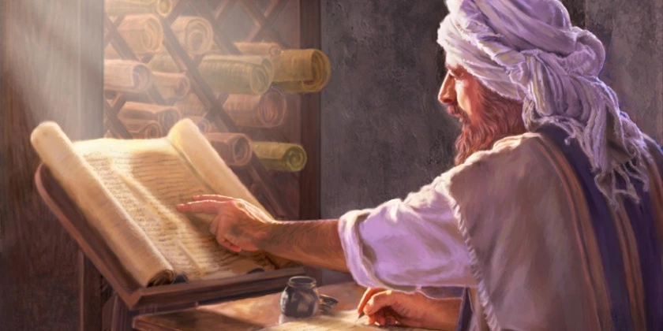
The Translation Processes
God divided the world by language at babel.
The old testament was written in Hebrew and some Aramaic
Jesus and the Apostles spoke and wrote in Greek and quoted from the Septuagint
Notes:
Greek translation of the Hebrew text en vogue in first-century Palestine. Some think this translation was achieved by 72 Jewish scholars who were invited to Alexandria, Egypt roughly two and a half centuries before Christ. Though considered by scholars as an imperfect translation of the Hebrew

Slide 40
The Translation Processes
“We can confidently affirm that we have 999/1000ths of the original Greek New Testament intact. The remaining 1/1000th pertains to inconsequential details.”
-Dave Miller
Notes:
Greek translation of the Hebrew text en vogue in first-century Palestine. Some think this translation was achieved by 72 Jewish scholars who were invited to Alexandria, Egypt roughly two and a half centuries before Christ. Though considered by scholars as an imperfect translation of the Hebrew

Slide 41
The Authenticity of Scripture
The New Testament has been preserved
The translation process works
The New Testament is factually accurate

Slide 42
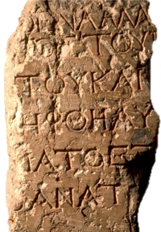
New Testament & Archeology
The Pilate Inscription
Politarchs in Thessalonica
Sergius Paulus the Proconsul of Cyprus
Gallio, Proconsul of Achaia
Death by Crucifixion
Counting Quirinius
Gentiles and the Temple

Slide 43
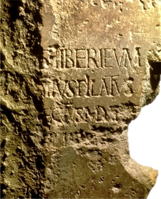
The Pilate Inscription
For 2000 years the only references to Pontius Pilot were from the NT, Josephus, and Tacitus
In 1961, a team of archeologist working in Caesarea discovered a two-foot by three-foot slab of rock that was used in construction of a Roman theater bearing Pontius Pilot’s name.

Slide 44
Overview
The Importance of the Resurrection
The Historicity of Christ
The Authenticity of Scripture
Who was Jesus?
The Resurrection
Application

Slide 45
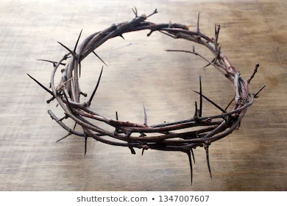
Who Was Jesus?
Many non-Christians may accept the fact that Jesus existed and even died on a cross.
This then begs the question, who was Jesus if He was not the Son of God?

Slide 46
“I am trying here to prevent anyone saying the really foolish thing that people often say about Him: “I’m ready to accept Jesus as a great moral teacher, but I don’t accept His claim to be God.” That is one thing we must not say. A man who was merely a man and said the sort things Jesus said would not be a great moral teacher. He would either be a lunatic – on a level with the man who says he is a poached egg – or else he would be the Devil of Hell. You must make your choice. Either this man was, and is, the Son of God: or else a madman or something worse….

Slide 47
“…You can shut Him up a fool, you can spit at Him and kill Him as a demon; or you can fall at His feet and call Him Lord and God. But let us not come up with any patronizing nonsense about His being a great human teacher. He has not left that open to us. He did not intend to.”
C.S. Lewis, Mere Christianity

Slide 48
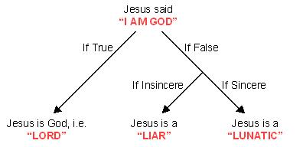
Who Was Jesus?
Lord?
Liar?
Lunatic?

Slide 49
Was Jesus a Liar?
How could a liar control the fulfillment of over 300 prophecies?
The birth place of Christ
Family lineage
Betrayed by disciple for 30 pieces of silver
His death, lots cast for clothes, pierced through the side, no bone broken
Why would a Liar willingly die for a lie?

Slide 50
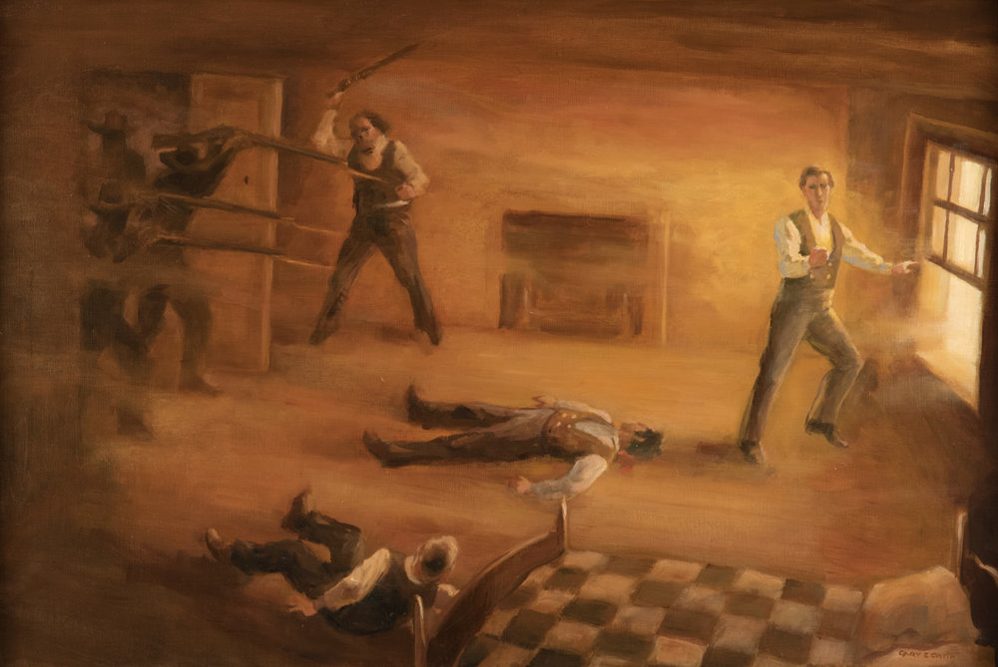
Jesus Christ vs Joseph Smith
Notes:
Joseph Smith and brother Hyrum awaited trial in 1844 in Illinois. They had been ridiculed for the practice of polygamy and fought against the press. As a result a mob came to kill them but they had a pistol snuck into their cell prior which they used to fight back.
Or David Koresh in 1993 in Waco TX. Fought with federal agents for over a month. Claimed he was the lord.

Slide 51
Was Jesus a Lunatic?
How could a lunatic teach and carry out the great moral teachings of Jesus Christ?
Treat others the way you want to be treated
Love your neighbor as yourself
Care for the widows and orphans
Turn the other cheek
Don’t have sex before marriage, abstain from alcohol, dress modestly
Teaching brought forth the most prosperous nation of all time!

Slide 52
Who Was Jesus?
Lord?
Liar?
Lunatic?

Slide 53
Overview
The Importance of the Resurrection
The Historicity of Christ
The Authenticity of Scripture
Who was Jesus?
The Resurrection
Application

Slide 54
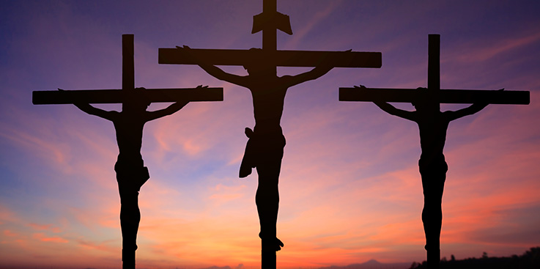
Jesus Died
Mathew 27:35-50
Mark 15:27-37
Luke 23:33-46
John 19:23-30

Slide 55
Talmud – Jewish Rabbis
“Jesus of Nazareth was a transgressor in Israel who practiced magic, scorned the words of the wise, led the people astray, and said that he had not come to destroy the law but to add to it. He was hanged on Passover Eve for heresy and misleading the people.”
(Bruce, 1953, p. 102)
Notes:
The Talmud is the central text of Rabbinic Judaism and the primary source of Jewish religious law and Jewish theology

Slide 56
Josephus
“There arose about this time Jesus, a wise man.... And when Pilate had condemned him to the cross on his impeachment by the chief men among us, those who had loved him at first did not cease.”
(Antiquities of the Jews, 18.3.3)

Slide 57
The Tomb was Empty
“A godless and lawless heresy had sprung from one Jesus, a Galilean deceiver, whom we crucified, but his disciples stole him by night from the tomb where he was laid when unfastened from the cross, and now deceive men by asserting that he has risen from the dead and ascended to heaven.”
Justin Martyr, Dialogue with Trypho
Notes:
A.D. 165, Justin Martyr penned his Dialogue with Trypho. At the beginning of chapter 108 of this work, he recorded a letter that the Jewish community had been circulating concerning the empty tomb of Christ:

Slide 58
The Tomb was Empty
“A diligent search was made and he [Jesus] was not found in the grave where he had been buried. A gardener had taken him from the grave and had brought him into his garden and buried him in the sand over which the waters flowed into the garden”
Toledoth Yeshu, Sixth Century
Notes:
Somewhere around the sixth century, another caustic treatise written to defame Christ circulated among the Jewish community. In this narrative, known as Toledoth Yeshu, Jesus was described as the illegitimate son of a soldier named Joseph Pandera. He also was labeled as a disrespectful deceiver who led many away from the truth. Near the end of the treatise, under a discussion of His death, the following paragraph can be found:

Slide 59
Where’s the body of Christ?

Slide 60
Biblical Accounts of the Resurrection
John 20:10-18 – Mary Magdalene
Mathew 28:1-10 – Mary with Women
1 Corinthians 15:5 – Peter
Luke 24:13-35 – Two Disciples
Luke 24:36-49; John 20:19-23 – Ten Disciples
John 20:24-31 – Eleven Disciples

Slide 61
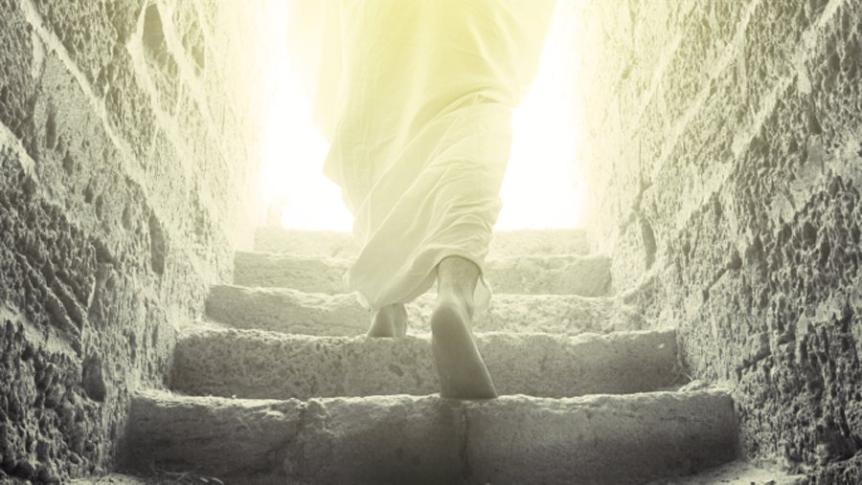
Biblical Accounts of the Resurrection
John 21 – Seven Disciples
Mathew 28:16-20; Mark 16:14-18 – All Disciples
1 Corinthians 15:6 – 500 Brethren
1 Corinthians 15:7 – James
Acts 1:4-8 – All Apostles
Acts 9:1-9; 1 Corinthians 15:8 - Paul

Slide 62
If the resurrection never happened, does the written record and the actions of the apostles indicate forgery?

Slide 63
500 People at Once
and that He was buried, and that He rose again the third day according to the Scriptures, and that He was seen by Cephas, then by the twelve. After that He was seen by over five hundred brethren at once, of whom the greater part remain to the present, but some have fallen asleep. After that He was seen by James, then by all the apostles. Then last of all He was seen by me also, as by one born out of due time.
1 Cor. 15:4-8

Slide 64
Saul Who Became Paul
Paul was an intelligent well trained individual.
Paul persecuted the church
Acts 8:3 - for Saul, he made havoc of the church, entering every house, and dragging off men and women, committing them to prison. (Acts 9:1-2, 1 Cor. 15:9).
Paul became an advocate for Christianity

Slide 65
Philippians 3:3-7
For we are the circumcision, who worship God in the Spirit, rejoice in Christ Jesus, and have no confidence in the flesh, though I also might have confidence in the flesh. If anyone else thinks he may have confidence in the flesh, I more so: circumcised the eighth day, of the stock of Israel, of the tribe of Benjamin, a Hebrew of the Hebrews; concerning the law, a Pharisee; concerning zeal, persecuting the church; concerning the righteousness which is in the law, blameless. But what things were gain to me, these I have counted loss for Christ.

Slide 66
Christians Willing to Die
People may ignorantly die for a lie but they do not willingly die for a lie
Paul likely beheaded by emperor Nero
James put to death with the sword (Acts 12:2)
Stoning of Steven (Acts 7)
Andrew crucified on an “X” shaped cross
John boiled alive but survived. Only Apostle to die natural death

Slide 67
Pliny the Younger
“Having never been present at any trials of the Christians, I am unacquainted with the method and limits to be observed either in examining or punishing them…In the meanwhile, the method I have observed towards those who have been denounced to me as Christians is this: I interrogated them whether they were Christians; if they confessed it I repeated the question twice again, adding the threat of capital punishment; if they still persevered, I ordered them to be executed”
Notes:
From Letters

Slide 68
Women First to See Christ
Mathew 28:1-10 – Mary Magdalene and other Mary
Mark 16:1-11 – Mary Magdalene, Mary the mother of James, and Salome
Luke 24:1-10 – Mary Magdalene, Joanna, Mary the mother of James, and other women
John 20:10-18 – Mary Magdalene
Why would the gospel writers make up women as the first to see Christ when viewed as less credible witnesses in that culture?

Slide 69
Overview
The Importance of the Resurrection
The Historicity of Christ
The Authenticity of Scripture
Who was Jesus?
The Resurrection
Application

Slide 70
Application
What the Resurrection means to Christians
What the Resurrection requires of Christians
Mathew 28:18-20
And Jesus came and spoke to them, saying, “All authority has been given to Me in heaven and on earth. Go therefore and make disciples of all the nations, baptizing them in the name of the Father and of the Son and of the Holy Spirit, teaching them to observe all things that I have commanded you; and lo, I am with you always, even to the end of the age.” Amen.

Slide 71
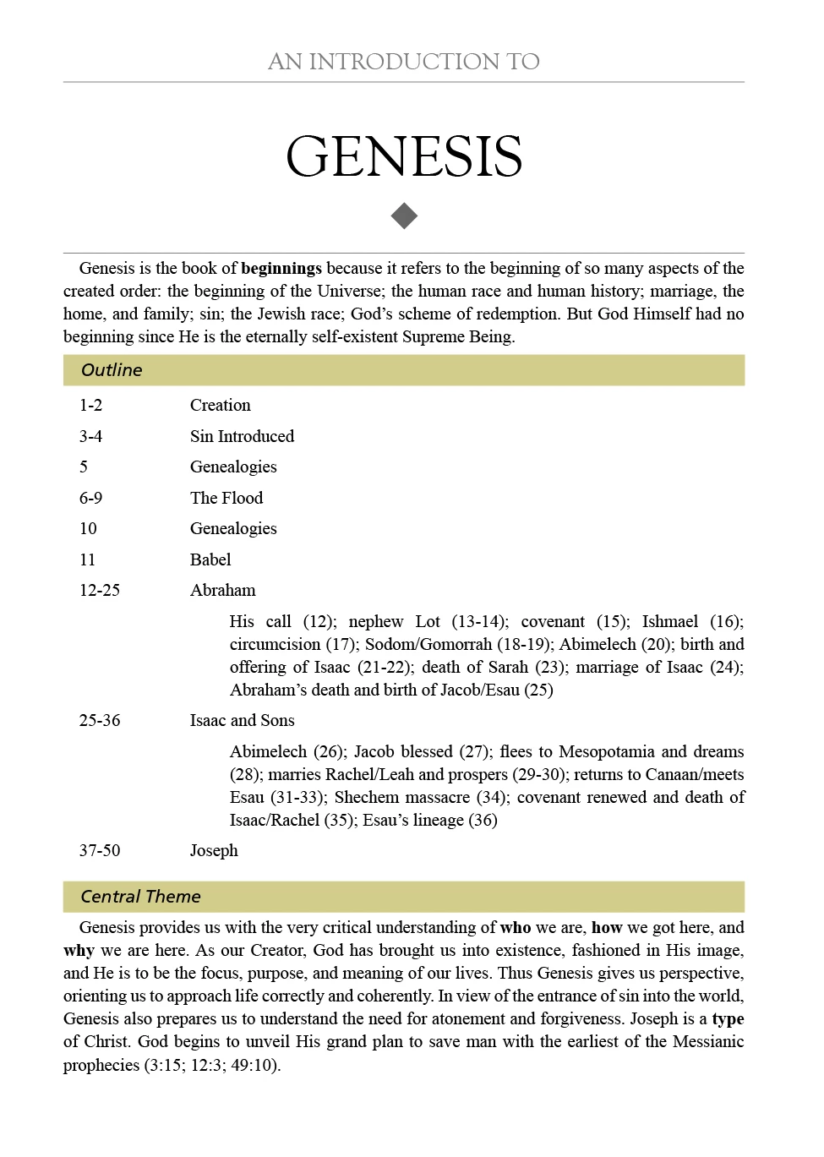
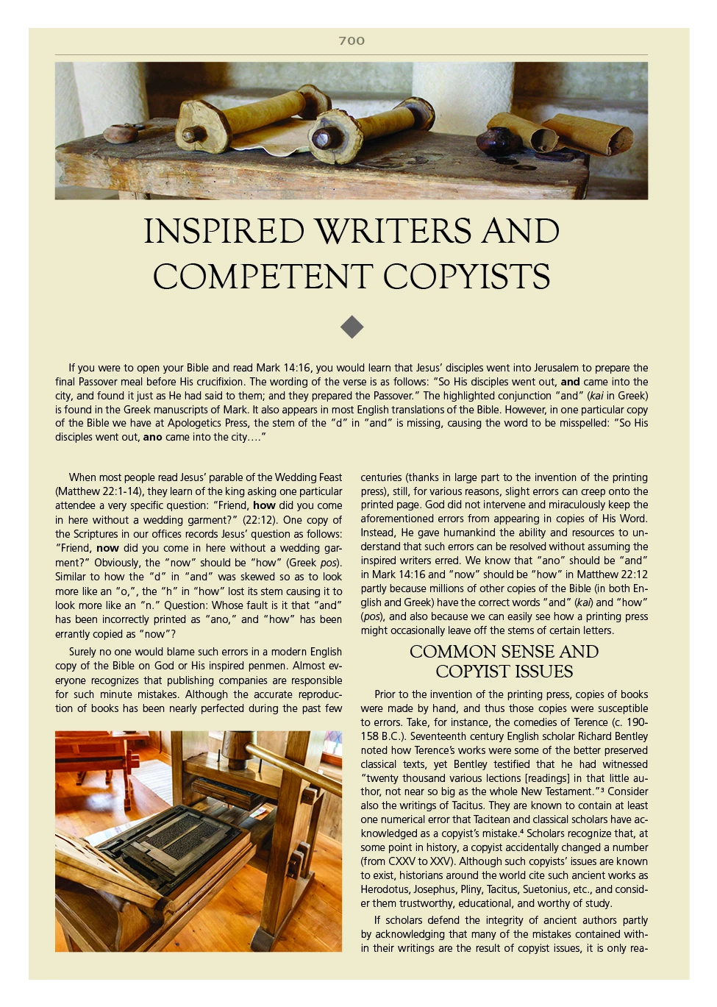
Covers topics such as God’s existence, Science and the Bible, God’s Justice and Hell, Defending the Bible’s Position on Prayer, Theistic Evolution, and The Bible and Slavery.

