Slide 2
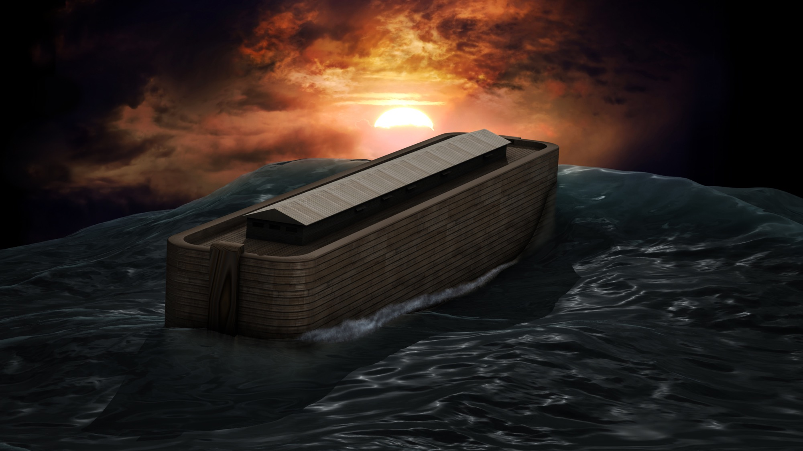
THE FEASIBILITY of the ARK
Paden Reed, M.S.

Slide 3
1 Peter 3:15
But sanctify the Lord God in your hearts, and always be ready to give a defense to everyone who asks you a reason for the hope that is in you, with meekness and fear;

Slide 4
Ether 2:16-25
And the Lord said: Go to work and build, after the manner of barges which ye have hitherto built. And it came to pass that the brother of Jared did go to work, and also his brethren, and built barges after the manner which they had built, according to the instructions of the Lord. And they were small, and they were light upon the water, even like unto the lightness of a fowl upon the water.
Notes:
The Jaredites prepare for their journey to a promised land—It is a choice land whereon men must serve Christ or be swept off—The Lord talks to the brother of Jared for three hours—The Jaredites build barges—The Lord asks the brother of Jared to propose how the barges will be lighted.

Slide 5
Ether 2:16-25
And the Lord said: Go to work and build, after the manner of barges which ye have hitherto built. And it came to pass that the brother of Jared did go to work, and also his brethren, and built barges after the manner which they had built, according to the instructions of the Lord. And they were small, and they were light upon the water, even like unto the lightness of a fowl upon the water.
Notes:
The Jaredites prepare for their journey to a promised land—It is a choice land whereon men must serve Christ or be swept off—The Lord talks to the brother of Jared for three hours—The Jaredites build barges—The Lord asks the brother of Jared to propose how the barges will be lighted.

Slide 6
Ether 2:16-25
And they were built after a manner that they were exceedingly tight, even that they would hold water like unto a dish; and the bottom thereof was tight like unto a dish; and the sides thereof were tight like unto a dish; and the ends thereof were peaked; and the top thereof was tight like unto a dish; and the length thereof was the length of a tree; and the door thereof, when it was shut, was tight like unto a dish.

Slide 7
Ether 2:16-25
And they were built after a manner that they were exceedingly tight, even that they would hold water like unto a dish; and the bottom thereof was tight like unto a dish; and the sides thereof were tight like unto a dish; and the ends thereof were peaked; and the top thereof was tight like unto a dish; and the length thereof was the length of a tree; and the door thereof, when it was shut, was tight like unto a dish.

Slide 8
Ether 2:16-25
And it came to pass that the brother of Jared cried unto the Lord, saying: O Lord, I have performed the work which thou hast commanded me, and I have made the barges according as thou hast directed me. And behold, O Lord, in them there is no light; whither shall we steer? And also we shall perish, for in them we cannot breathe, save it is the air which is in them; therefore we shall perish.

Slide 9
Ether 2:16-25
And it came to pass that the brother of Jared cried unto the Lord, saying: O Lord, I have performed the work which thou hast commanded me, and I have made the barges according as thou hast directed me. And behold, O Lord, in them there is no light; whither shall we steer? And also we shall perish, for in them we cannot breathe, save it is the air which is in them; therefore we shall perish.

Slide 10
Ether 2:16-25
And the Lord said unto the brother of Jared: Behold, thou shalt make a hole in the top, and also in the bottom; and when thou shalt suffer for air thou shalt unstop the hole and receive air. And if it be so that the water come in upon thee, behold, ye shall stop the hole, that ye may not perish in the flood.

Slide 11
Ether 2:16-25
And the Lord said unto the brother of Jared: Behold, thou shalt make a hole in the top, and also in the bottom; and when thou shalt suffer for air thou shalt unstop the hole and receive air. And if it be so that the water come in upon thee, behold, ye shall stop the hole, that ye may not perish in the flood.

Slide 12
Ether 2:16-25
And he cried again unto the Lord saying: O Lord, behold I have done even as thou hast commanded me; and I have prepared the vessels for my people, and behold there is no light in them. Behold, O Lord, wilt thou suffer that we shall cross this great water in darkness?

Slide 13
Ether 2:16-25
And the Lord said unto the brother of Jared: What will ye that I should do that ye may have light in your vessels? For behold, ye cannot have windows, for they will be dashed in pieces; neither shall ye take fire with you, for ye shall not go by the light of fire.

Slide 14
Ether 2:16-25
And the Lord said unto the brother of Jared: What will ye that I should do that ye may have light in your vessels? For behold, ye cannot have windows, for they will be dashed in pieces; neither shall ye take fire with you, for ye shall not go by the light of fire.
Notes:
Jared never gives an answer and the “lord” never provides a way for them to see.

Slide 15
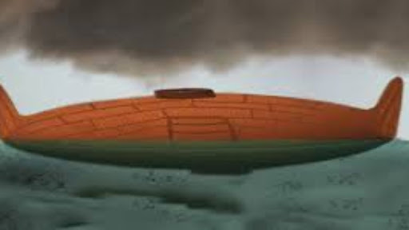
The Mormon Barge
Ether 2

Slide 16
Overview
The Design of the Ark
Skeptics Objections to the Ark
Application

Slide 17
The Design of the Ark
Genesis 6:13-16
And God said to Noah, “The end of all flesh has come before Me, for the earth is filled with violence through them; and behold, I will destroy them with the earth. Make yourself an ark of gopherwood; make rooms in the ark, and cover it inside and outside with pitch. And this is how you shall make it: The length of the ark shall be three hundred cubits, its width fifty cubits, and its height thirty cubits. You shall make a window for the ark, and you shall finish it to a cubit from above; and set the door of the ark in its side. You shall make it with lower, second, and third decks.

Slide 18
The Design of the Ark
The Ark was to be constructed of “gopherwood”
It was to measure 300 cubits long, 50 cubits wide, and 30 cubits high (with an 18-inch cubit = 450 x 75 x 45 feet)
Three decks with “rooms”
Covered in “pitch,” inside and out
Notes:
- The Ark was to be made of an unknown material transliterated by most
versions, “gopherwood” (Hebrew: goper)—unrelated to the north
American mammal by that name.
- The vessel was to be 300 cubits long, 50 cubits wide, and 30 cubits
high—thought by many to be roughly 450 x 75 x 45 feet, assuming an
18-inch cubit.
- Three decks were to be constructed within the vessel with an
unidentified number of “rooms” to house the Ark’s passengers.
- A material (“pitch”) was to be spread over the inside and outside of
the Ark, likely used as a sealant, insulator, and, possibly, a shock absorber

Slide 19
The Design of the Ark
The Ark was to be constructed of “gopherwood”
It was to measure 300 cubits long, 50 cubits wide, and 30 cubits high (with an 18-inch cubit = 450 x 75 x 45 feet)
Three decks with “rooms”
Covered in “pitch,” inside and out
One door in the side
One opening/”window” at the top
A covering/awning over the opening
Notes:
- A door was to be constructed in the side of the Ark.
- An opening was to be constructed in the Ark, apparently for light
(Genesis 6:16, ASV) and ventilation. This opening was probably fixed
like a window around the top of the Ark, one cubit below the top of
the vessel.
- A covering/awning was placed over the opening (Genesis 8:13), which
was later removed to allow Noah to view the Earth from within the vessel.

Slide 21
Overview
The Ark Account in Genesis
Skeptics Objections to the Ark
Ability to build the Ark?
Seaworthiness?
Gathering & Storing Animals?
Application

Slide 22
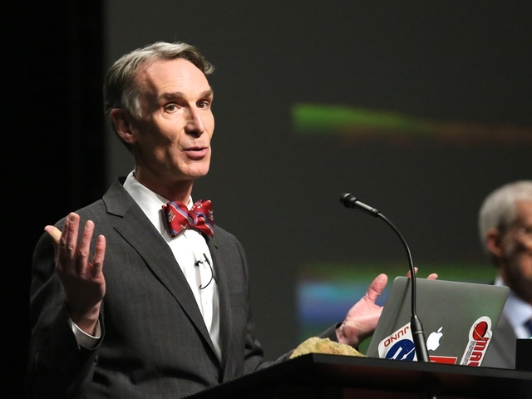
Ability to Build the Ark
“Somehow Noah and his family were able to build a wooden ship that would house 14,000 individuals…and these people were unskilled, as far as anybody knows they had never built a wooden ship before”
Bill Nye
(2014 Debate)

Slide 23
Notes:
Secular scientists inevitably portray ancient man as unintelligent, ape-like,
and brutish. After all, according to the evolutionary model, humans evolved
from ancestors that were not intelligent. How could ancient man, then, be
capable of engaging in advanced marine engineering?

Slide 24
Ability to Build the Ark
Better health, increased strength, mental acuity, and longer life during this time
Noah was 500 years old when had his firstborn son Japheth
Accounting for time for his son to mature and get married they had between ~55-75 years to build the ark
Possibility of additional family and hired labor to help
Notes:
When God made man he made him very good (Gen 1:31)
Giants on the earth in those days (Gen 6:4)
Genetic Entropy – Humans used to live longer, were likely stronger and smarter.
Genesis 6:3 says that God was giving mankind 120 years before the flood. This however does not mark the beginning of the building of the ark. Accounting for his sons to be born and be old enough to take wives and work on the ark, Noah would have spent between 55-75 years constructing the ark.
https://answersingenesis.org/bible-timeline/how-long-did-it-take-for-noah-to-build-the-ark/

Slide 25
Ability to Build the Ark
Agriculture was being conducted (4:2)
Civilizations were being built (4:17)
Musical instruments were designed/built (4:21)
Bronze and metal were being worked allowing the availability of metal tools/hardware (Genesis 4:22)
Notes:
Gen 4:2 - Now Abel was a keeper of sheep, but Cain was a tiller of the ground.
Gen 4:17…And he (Cain) built a city, and called the name of the city after the name of his son—Enoch.
Gen 4:21…He was the father of all those who play the harp and flute.
Gen 4:22 And as for Zillah, she also bore Tubal-Cain, an instructor of every craftsman in bronze and iron

Slide 26
Ability to Build the Ark
Boats were likely constructed before the Ark (Genesis 2:10-14; 1:28)
Noah, family, or hired hands may have been shipwrights by trade
The Master Builder helped him!
Notes:
Genesis 2:10-14 – Describes the rivers of the time and the various metals present in different lands
Gen 1:28 describes fishing in the sea

Slide 27
200,000
NOAH ALONE HAD APPROXIMATELY
WORKING HOURS
Notes:
75 years, 6 days a week (rest on Saturday), 8 hours a day, = 187k hours

Slide 28
800,000
NOAH AND HIS THREE SONS HAD
WORKING HOURS

Slide 29
1.6⁺MILLION
NOAH, HIS 3 SONS, & ALL 4 WIVES
WORKING HOURS

Slide 30
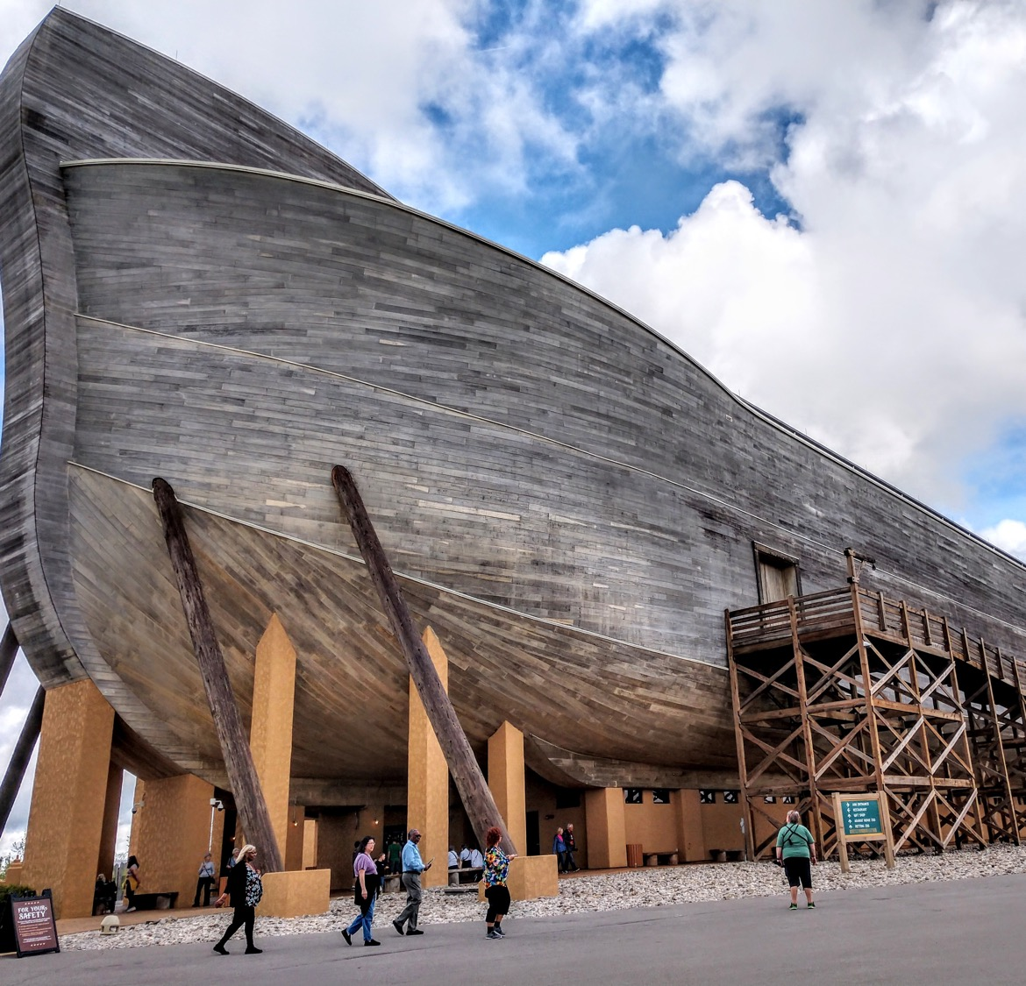
280,000
THE REPLICA IN KENTUCKY:
WORKING HOURS

Slide 31
Overview
The Ark Account in Genesis
Skeptics Objections to the Ark
Ability to build the Ark?
Seaworthiness?
Gathering and Storing Animals?
Application

Slide 32
Seaworthy?
“We can run a test, a scientific test. People in the early 19 hundreds built an extraordinary large wooden ship, the Wyoming. It was a six masted schooner, the largest one ever built. It had a motor on it for winching cables and stuff, but this boat had a great difficulty…It was a very long ship and would twist in the sea….and in all that twisting it leaked, it leaked like crazy. The crew could not keep the ship dry and indeed it did flounder and sank with the loss of all 14 hands”
Bill Nye
(2014 Debate)
Notes:
The Wyoming was a large wooden ship built in 1909 that sank in 1924 due to the
tendency of its long wooden planks to twist and buckle on the heavy seas.
Skeptics claim that the Ark, which was immensely larger, would have been
subject to the same problems and therefore could not have survived the
Flood, disproving the biblical account

Slide 34
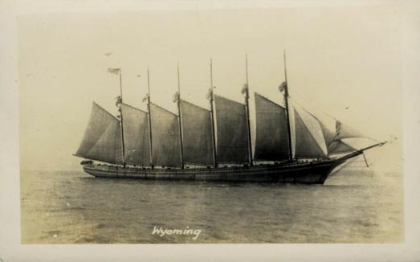
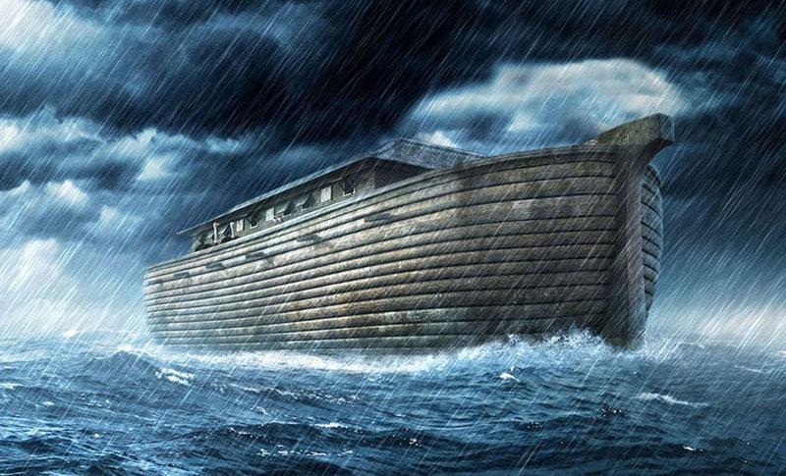
Seaworthy?
Wyoming lasted for 15 years….ark only needed to last for about 1 year
Wyoming had somewhere to be…. the ark did not
Wyoming had a few skilled but limited shipwrights….the ark had the Master Architect
Notes:
the Wyoming is in no way a parallel to the Ark. First consider that
the Wyoming was equipped with six enormous masts and several sails. The
torsion that would be generated from the wind filling those sails on the
open seas would certainly be significant—most definitely causing twisting,
buckling, and leakage. Sails, however, are used when the objective is for a
boat to go somewhere. The Ark had no destination. It merely needed to
float. So it would not have been equipped with sails, and the torsion problem would be significantly reduced
https://apologeticspress.org/APContent.aspx?category=9&article=4819

Slide 35
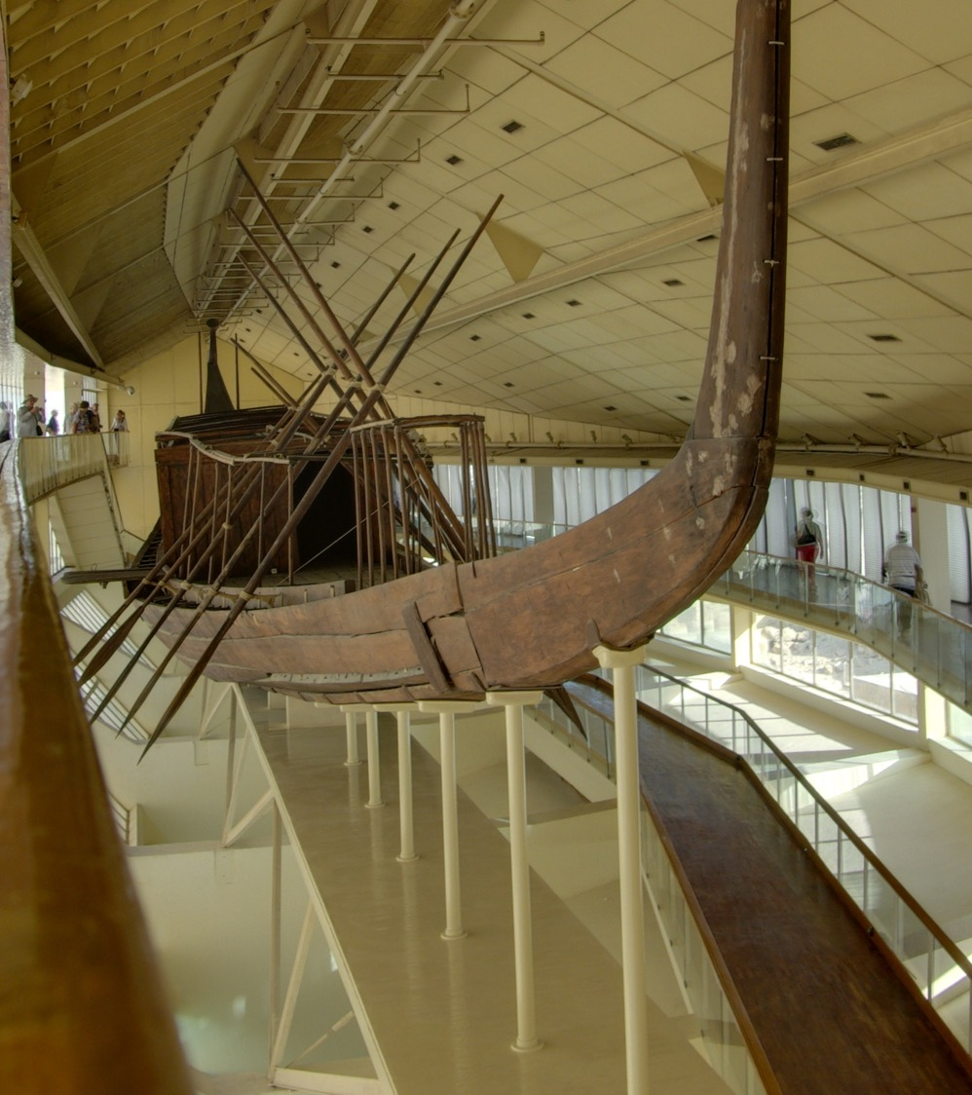
Large, ancient Egyptian vessel (Khufu) from 2,000⁺ B.C.
Mortise and Tenon Joint
Notes:
Such techniques were being used in the centuries immediately following the Flood on wooden ships 2,000 years ago in Northern Vietnam (Bellwood and Cameron, 2007), 2,800 years ago in Greece (Casson, 1991, pp. 28-29), 3,400 years ago in Turkey (Casson, pp. 28-29)—ironically, the very area where the Ark is thought to have rested after the Flood—and even 4,000-5,000 years ago in Egypt on massive, 150-foot wooden ships (O’Connor and Adams, 2001, pp. 44-45; Ward, 2001, p. 45). Mortise and tenon joints help prevent “the frame from twisting and makes it firmer, giving it added strength” (“Mortise and Tenon Joints,” 2009).
It is also notable that Genesis 7:16 indicates that God, Himself, sealed the Ark after its passengers boarded. God certainly would have known how to seal a vessel in a way that would prohibit leakage.
Further, archaeologists have discovered advanced ancient boat-building practices in Egypt which date to the centuries immediately following the Flood. Marine engineers were already using the interlocking plank system of mortise and tenon joints. Mortise and tenon joints are known to help prevent twisting and buckling.

Slide 36
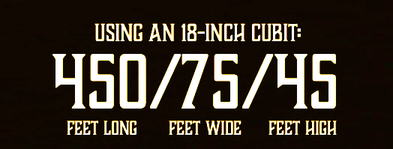
30 CUBITS
30 - 5 - 3 Ratio
50 CUBITS
300 CUBITS
Notes:
2014 Study by 4 physics students at the University of Leicester on whether or not the ark would actually float and how much weight it would hold. Published the results in Journal of Physics Special Topics.
“You don’t think of the Bible necessarily as a scientifically accurate source of information, so I guess we were quite surprised when we discovered it would work,” said Thomas Morris
They assumed the type of wood as cypress and a cubit as 19 inches, and as a result the boat empty would have only dipped a little over 1 ft in the water.
They then calculated the maximum weight it could hold and came up with ~111 million pounds. For perspective that is about 2.2 million sheep
https://www.smithsonianmag.com/science-nature/could-noahs-ark-float-theory-yes-180950385/

Slide 37
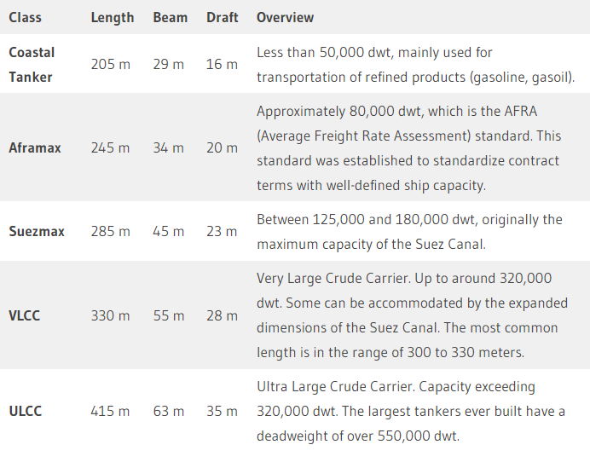
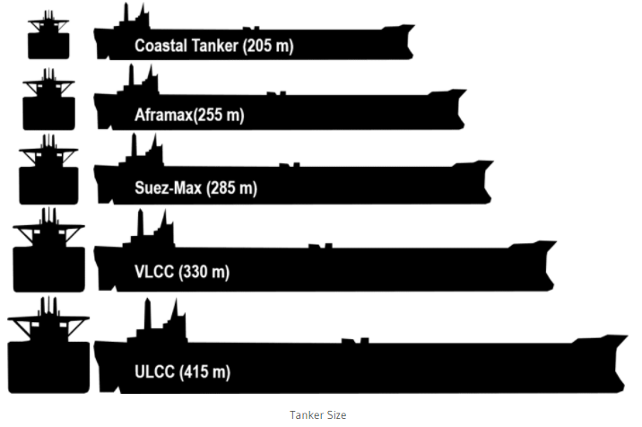
https://porteconomicsmanagement.org/pemp/contents/part8/ports-and-energy/tanker-size/
Notes:
Ratio Range from 7:1 to 6:1 with VLCC being 6:1 and ULCC being 6.6:1
VLCC (Very Large Crude Oil Carriers) and World War II cargo ships like the S.S.
Jeremiah O’Brien, for instance—both built to transport immense amounts
of material over harsh seas, like the Ark—have comparable dimension ratios
to that of the Ark.
DWT = Dead Weight Ton
https://porteconomicsmanagement.org/pemp/contents/part8/ports-and-energy/tanker-size/

Slide 38
Overview
The Ark Account in Genesis
Skeptics Objections to the Ark
Ability to build the Ark?
Seaworthiness?
Gathering & Storing Animals?
Application

Slide 39
Gathering & Storing Animals
“If there were 4,000 years since Ken Ham’s flood, and let’s say as he’s said many times there are 7,000 kinds. Today the very very lowest estimate is that there are about 8.7 million species, but a much more reasonable estimate is that there are 50 million even a hundred million…so we will take a number which I think is pretty reasonable, 16 million species today. If these came from 7 thousand kinds…we would expect to find 11 new species every day”
Bill Nye
(2014 Debate)

Slide 40
Gathering & Storing Animals
Genesis 7:2-3
You shall take with you seven each of every clean animal, a male and his female; two each of animals that are unclean, a male and his female; also seven each of birds of the air, male and female, to keep the species alive on the face of all the earth.
Notes:
NKJV uses the word species in v3, literal translation is seed or offspring

Slide 41
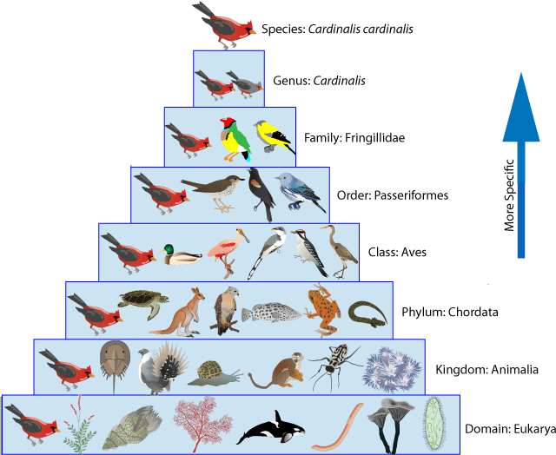
Gathering & Storing Animals
Species - a group of living organisms consisting of similar individuals capable of exchanging genes or interbreeding
Spaghetti – Species
Good – Genus
For – Family
Over – Order
Came – Class
Phillip – Phylum
King – Kingdom

Slide 42
Gathering & Storing Animals
Genesis 7:13-15
On the very same day Noah and Noah’s sons, Shem, Ham, and Japheth, and Noah’s wife and the three wives of his sons with them, entered the ark— they and every beast after its kind, all cattle after their kind, every creeping thing that creeps on the earth after its kind, and every bird after its kind, every bird of every sort. And they went into the ark to Noah, two by two, of all flesh in which is the breath of life.

Slide 43
Gathering & Storing Animals
Genesis 7:13-15
On the very same day Noah and Noah’s sons, Shem, Ham, and Japheth, and Noah’s wife and the three wives of his sons with them, entered the ark— they and every beast after its kind, all cattle after their kind, every creeping thing that creeps on the earth after its kind, and every bird after its kind, every bird of every sort. And they went into the ark to Noah, two by two, of all flesh in which is the breath of life.

Slide 44
Gathering & Storing Animals
Genesis 1:21
So God created great sea creatures and every living thing that moves, with which the waters abounded, according to their kind, and every winged bird according to its kind. And God saw that it was good.

Slide 45
Gathering & Storing Animals
Kind – מִין – miyn - Groups of living organisms belong in the same created "kind" if they have descended from the same ancestral gene pool.
Family - A taxonomic group of one or more genera, especially sharing a common attribute.
Notes:
This does not preclude new species because this represents a partitioning of the original gene pool. Information is lost or conserved—not gained. A new species could arise when a population is isolated and inbreeding occurs. By this definition a new species is not a new "kind" but a further partitioning of an existing "kind"

Slide 46
Notes:
2018 -> 1.8 million species

Slide 47
Notes:
2018 -> 1.8 million species

Slide 48
Notes:
2018 -> 1.8 million species
66k species air breathing and land dependent animals
Genesis 6:17 And behold, I Myself am bringing floodwaters on the earth, to destroy from under heaven all flesh in which is the breath of life; everything that is on the earth shall die.

Slide 49
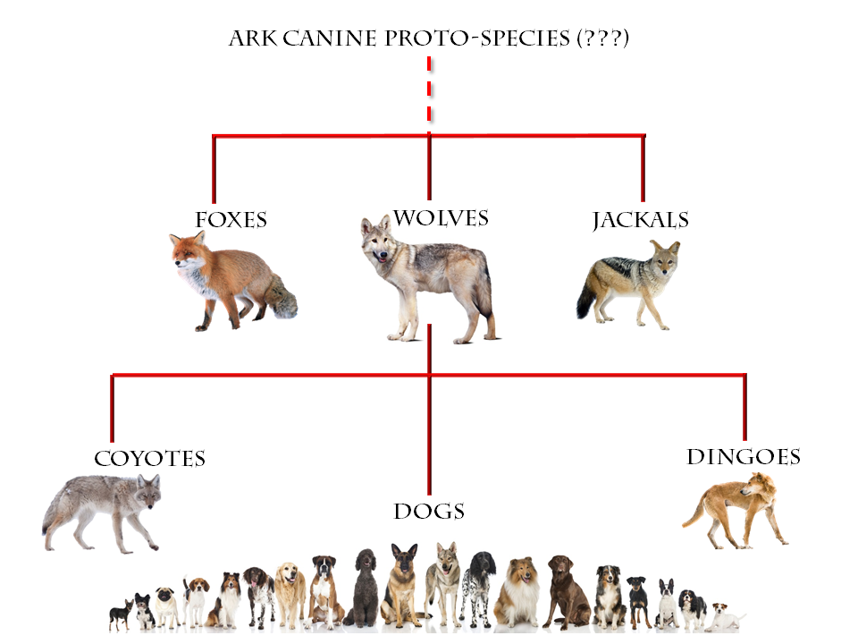
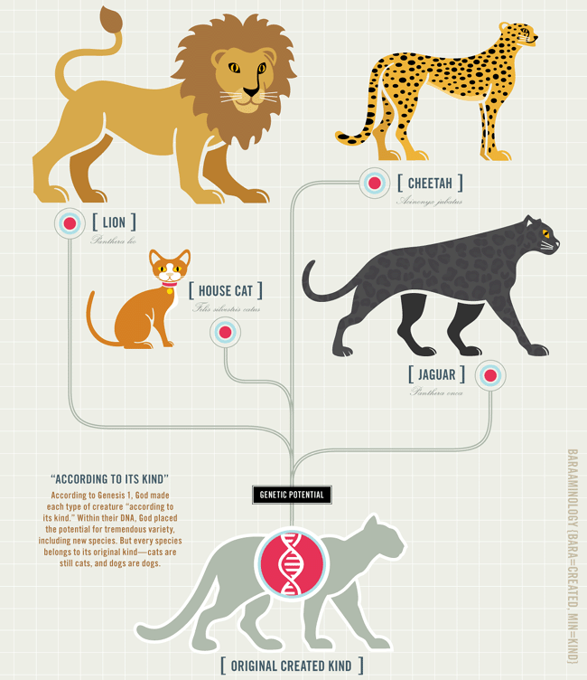

Slide 50
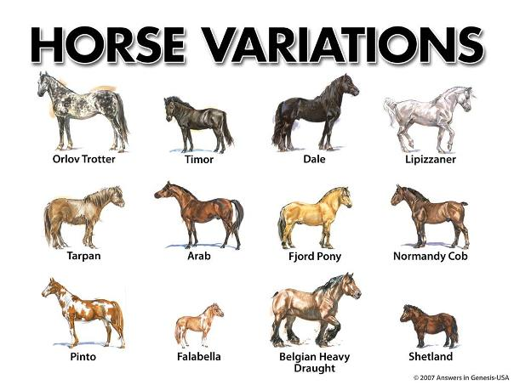
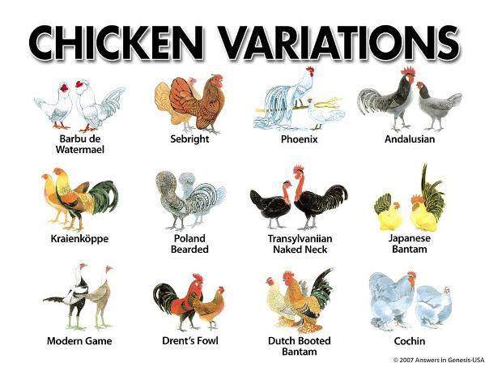
Notes:
7000 kinds that would have boarded the ark
What about large animals like dinosaurs, elephants, and giraffes?

Slide 51
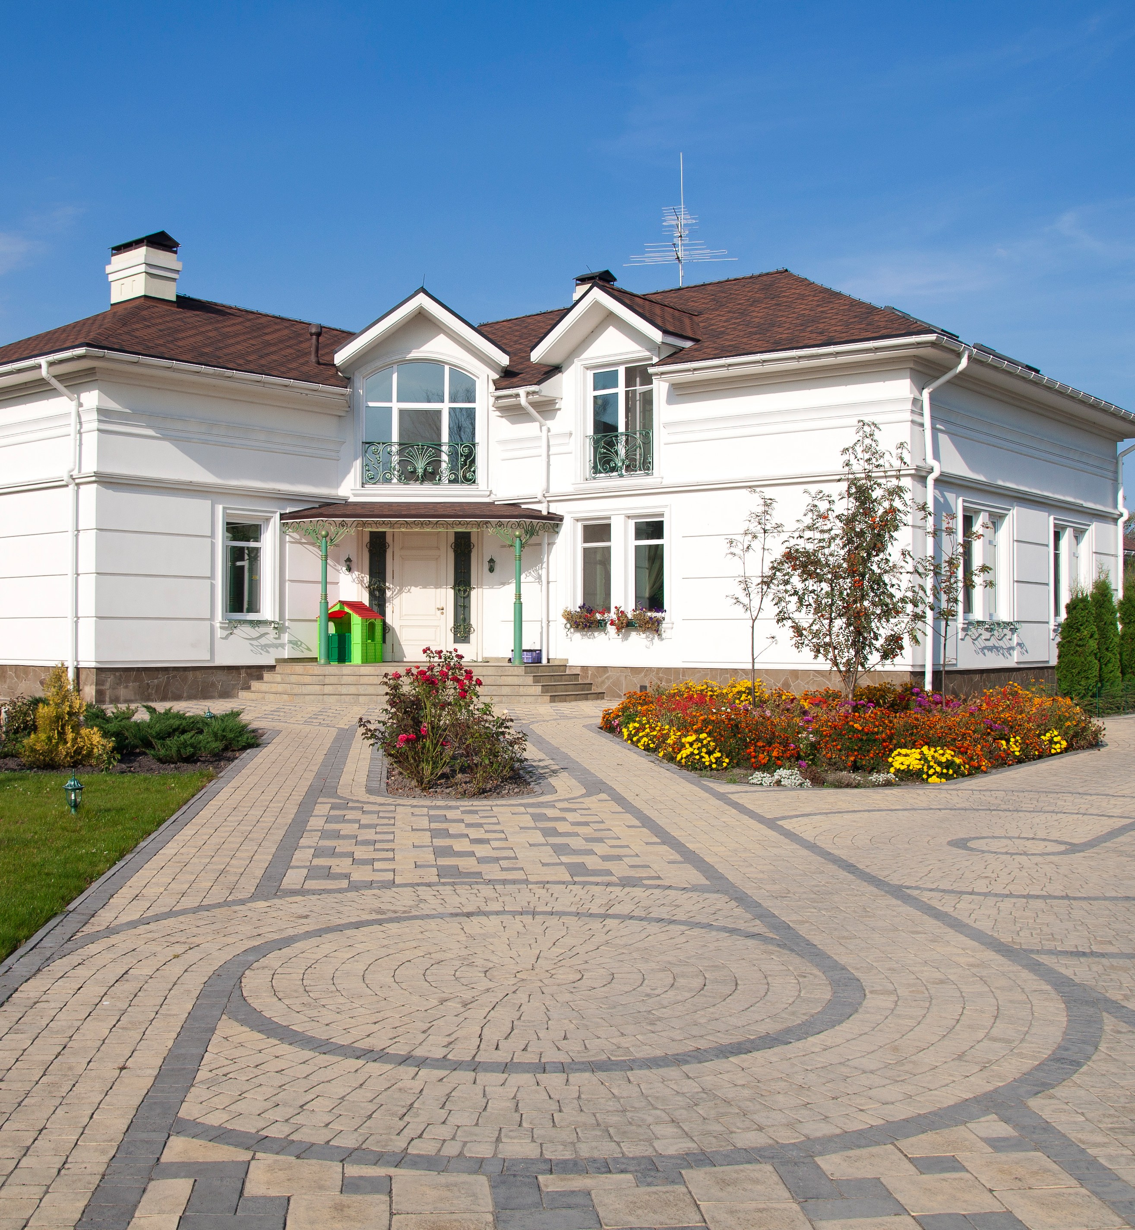
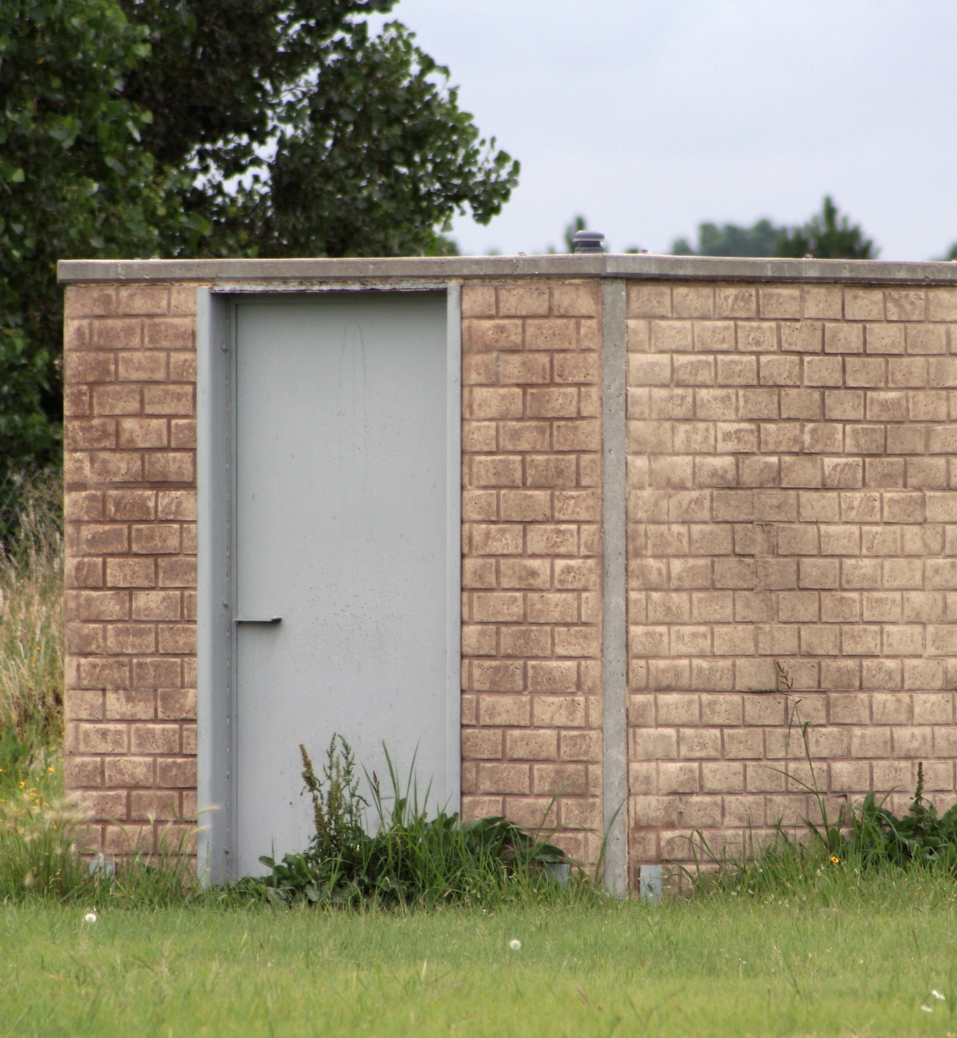
Notes:
2.2 million sheep from 2014 physics study. Did Noah need to take full grown mature animals? Most animals are small not large.
Just like if you have been on a ship you don’t stay in large mansion rooms, you stay in small fit for purpose rooms.

Slide 52
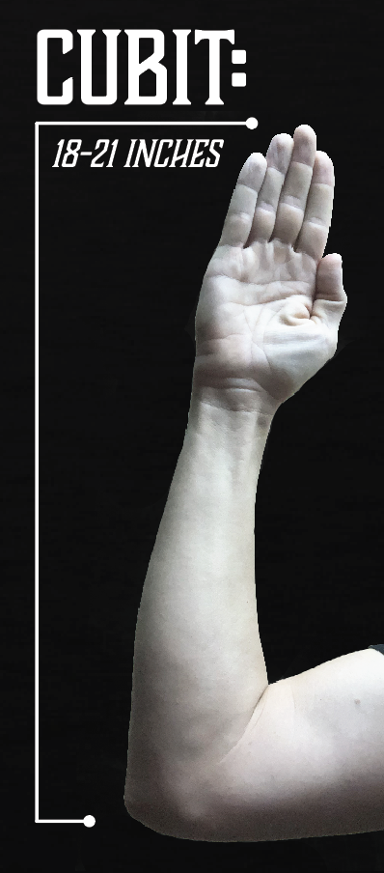
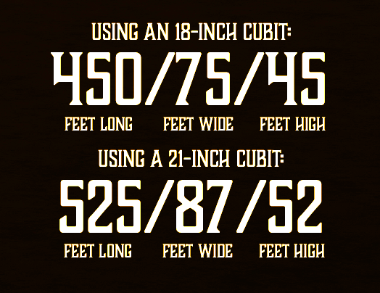
A 25-INCH CUBIT WOULD MORE THAN DOUBLE THE VOLUME OF SPACE WITHIN
THE ARK!
1,518,750 CUBIC FEET
VS.
4,062,500 CUBIC FEET

Slide 53
Overview
The Ark Account in Genesis
Skeptics Objections to the Ark
Ability to build the Ark?
Seaworthiness?
Gathering & Storing Animals?
Application

Slide 54
What does the Ark Teach Us?
We gain confidence in the word of God knowing that the ark account is feasible.
We learn important parallels between the old testament account of the ark and the new testament account of the church.

Slide 55
SOME COMPARISONS:
THE ARK
HEBREWS 11:7; MATTHEW 16:18; EPHESIANS 5:23
Notes:
Hebrews 11:7 By faith Noah, being warned by God concerning events as yet unseen, in reverent fear constructed an ark for the saving of his household. By this he condemned the world and became an heir of the righteousness that comes by faith.
Mathew 16:18 And I also say to you that you are Peter, and on this rock I will build My church, and the gates of Hades shall not prevail against it.
Ephesians 5:23 For the husband is head of the wife, as also Christ is head of the church; and He is the Savior of the body

Slide 56
SOME COMPARISONS:
THE ARK
HEBREWS 11:7; MATTHEW 16:18; EPHESIANS 5:23
THE DOOR
GENESIS 6:16; JOHN 10:7,9; 14:6
Notes:
Gen 6:16 – Noah commanded to make a door in the Ark
John 10:7, 9 – Jesus is the door through which leads salvation

Slide 57
SOME COMPARISONS:
THE ARK
HEBREWS 11:7; MATTHEW 16:18; EPHESIANS 5:23
THE DOOR
GENESIS 6:16; JOHN 10:7,9; 14:6
THE WATER
I PETER 3:20,21; ROMANS 6:3-4;
GALATIANS 3:27; HEBREWS 2:3

